Slide 1
Lanthanoids and Actinoids
Dr Semanti Basu
Assistant Professor
Department of Chemistry
Bejoy Narayan Mahavidyalaya Itachuna, Hooghly, W.B., India

Slide 2
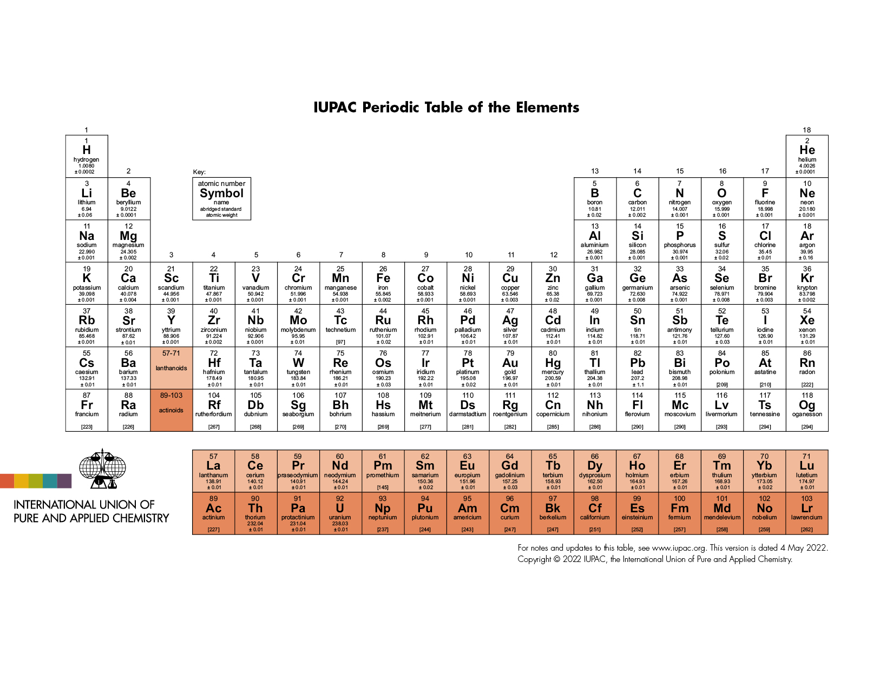

Slide 3
Syllabus
Electronic configuration
Lanthanide Contraction
Oxidation State
Colour & spectral properties
Magnetic properties
Separation of Lanthanides (ion exchange method only)

Slide 4
f-block elements
The f-block elements are those elements whose last electron (differentiating electron) enters into the (n-2)f-orbital at the valence shell. General electronic configuration of them is ns² (n-1)d⁰⁻¹ (n-2)f⁰⁻¹⁴ . Since the last electron of them enter into (n-2) shell, they are called inner-transition elements. If the last electron enter into 4f orbital then are called Lanthanide and if enters into 5f orbital then they are called Actinide
All the f-block elements are metal.

Slide 5
f-block elements
A total of 14 elements (₅₈Ce to ₇₁Lu) of lanthanide are placed in the place of group 3 and period 6. Though there is no electron at 4f orbital of Lanthanum (₅₇La), La are placed at the Lanthanide group because the properties of La is similar with the other 14 elements. There 15 elements of Lanthanide group are generally represented by “Ln”. The old name of Ln are rare earth elements.

Slide 6
f-block elements
A total of 14 elements of Actinide are placed in the place of group 3 and period 7. Therefore f-block elements have two series:
Lanthanide series or 4f series: Cerium (₅₈Ce) to Lutetium (₇₁Lu) total 14 elements are in this series. IUPAC recommended name is lanthanoid and the widely used name is lanthanide. General electronic configuration is [Xe]6s² 4f¹⁻¹⁴ 5d⁰⁻¹
Actinide series or 5f series: Thorium (₉₀Th) to Lawrencium (₁₀₃Lr) total 14 elements. These 14 elements are radioactive. From Americium (₉₅Am) to Lawrencium ₁₀₃Lr, 8 elements are artificially made elements. IUPAC recommended name is actinoids and the widely used name is actinides. General electronic configuration is [Rn]7s² 5f¹⁻¹⁴ 6d⁰⁻¹

Slide 7
Lanthanides (Ce to Lu) (or lanthanoids) and actinides (Ac to Lr) (or actinoids):
The placement of the lanthanides or actinides in a particular position is justified from the fact that the properties of the members in each family (ie lanthanides or actinides) are very much comparable though their atomic weight (more correctly atomic number) changes from one member to another.

Slide 8
Position in Periodic table – In 6th period & Group 3 after La the incoming electron enters the 4f orbital and the following 14 elements are called Lanthanide/Lanthanones. Placed outside the body of main periodic table as they resemble each other very closely and keeping them inside the main table will over rule periodic law.
Electronic configuration - The general electronic configuration of these elements is
ns² (n-1)d⁰⁻¹ (n-2)f¹⁻¹⁴
They resemble each other very closely as they have same electronic configuration in nth and (n-1) valency shell. Their most common oxidation state is +3 involving only 5d1 and 6s2 electrons. An alternate electronic configuration is also suggested that after Ce, the d electron also shifts to 4f orbital, except for those elements where it will disturb f¹ or f¹⁴ configuration.

Slide 9
For lanthanides
General Electronic configuration is [Xe]6s² 4f⁰⁻¹⁴ 5d⁰⁻¹

Slide 10
Element | Symbol | Idealized | Observed | Ln(+3) | Radius of Ln(+3) in pm
Lanthanum | ₅₇La | [Xe]6s² 4f⁰ 5d¹ | [Xe]6s² 4f⁰ 5d¹ | [Xe]4f⁰
 | ₅₈Ce | [Xe]6s² 4f¹ 5d¹ | [Xe]6s² 4f² 5d⁰ | [Xe]4f¹ | 114
 | ₅₉Pr | [Xe]6s² 4f² 5d¹ | [Xe]6s² 4f³ 5d⁰ | [Xe]4f² | 113
 | ₆₀Nd | [Xe]6s² 4f³ 5d¹ | [Xe]6s² 4f⁴ 5d⁰ | [Xe]4f³ | 111
 | ₆₁Pm | [Xe]6s² 4f⁴ 5d¹ | [Xe]6s² 4f⁵ 5d⁰ | [Xe]4f⁴ | 109
 | ₆₂Sm | [Xe]6s² 4f⁶ 5d⁰ | [Xe]6s² 4f⁶ 5d⁰ | [Xe]4f⁵ | 108
 | ₆₃Eu | [Xe]6s² 4f⁷ 5d⁰ | [Xe]6s² 4f⁷ 5d⁰ | [Xe]4f⁶ | 107
 | ₆₄Gd | [Xe]6s² 4f⁷ 5d¹ | [Xe]6s² 4f⁷ 5d¹ | [Xe]4f⁷ | 105
 | ₆₅Tb | [Xe]6s² 4f⁸ 5d¹ | [Xe]6s² 4f⁹ 5d⁰ | [Xe]4f⁸ | 104
 | ₆₆Dy | [Xe]6s² 4f⁹ 5d¹ | [Xe]6s² 4f¹⁰ 5d⁰ | [Xe]4f⁹ | 103
 | ₆₇Ho | [Xe]6s² 4f¹⁰ 5d¹ | [Xe]6s² 4f¹¹ 5d⁰ | [Xe]4f¹⁰ | 102
 | ₆₈Er | [Xe]6s² 4f¹¹ 5d¹ | [Xe]6s² 4f¹² 5d⁰ | [Xe]4f¹¹ | 100
 | ₆₉Tm | [Xe]6s² 4f¹² 5d¹ | [Xe]6s² 4f¹³ 5d⁰ | [Xe]4f¹² | 99
 | ₇₀Yb | [Xe]6s² 4f¹³ 5d¹ | [Xe]6s² 4f¹⁴ 5d⁰ | [Xe]4f¹³ | 99
 | ₇₁Lu | [Xe]6s² 4f¹⁴ 5d¹ | [Xe]6s² 4f¹⁴ 5d¹ | [Xe]4f¹⁴ | 98

Slide 11
2. f-CONTRACTION OR LANTHANIDE AND ACTINIDE CONTRACTION
Lanthanide contraction (4f) and actinide contraction (5f) both are called f-contraction. The term "lanthanide contraction" refers to the larger than expected decrease in atomic or ionic radii (M³⁺ ions) of lanthanide elements (4f) from lutetium (₇₁Lu) to lanthanum (₅₇La) (fig.).
Similar to lanthanide, the atomic and ionic radii of the actinide series (Th to Lr) progressively decrease larger than expected as the atomic number increases. this decrease in size is referred to as actinide contraction.

Slide 12
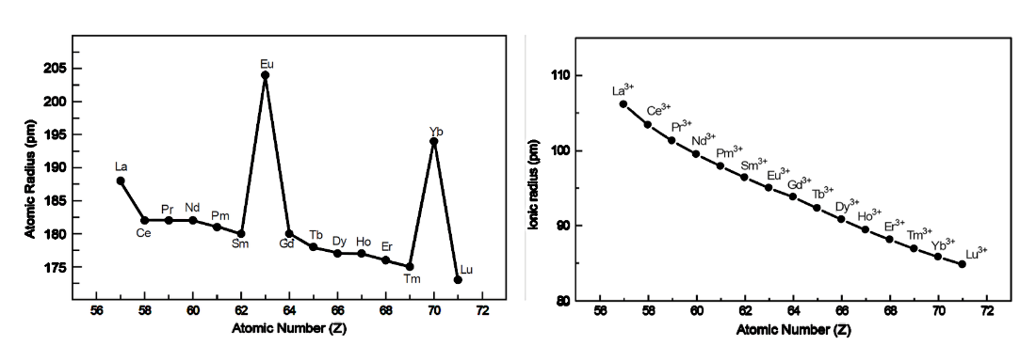
The ionic radii of Ln⁺³ exhibit a consistent downward trend from La⁺³ to Lu⁺³, although this trend is comparatively slower for the later members. Their metallic radii, however, do not decrease monotonically, leading to two hikes: at ₆₃Eu ([Xe]4f⁷ 5d⁰ 6s²) and ₇₀Yb ([Xe]4f¹⁴ 5d⁰ 6s²). The electronic configurations of these two elements are full-filled (Yb) and half-filled (Eu), which gives them extra stability.
(a) Atomic radius in Å and (b) Ionic radius (at +3 oxidation state) in Å of Lanthanide series

Slide 13
Cause of f-Contraction
Mainly f-contraction occurs for relativistic effect and increasing trend of effective nuclear charge (Z_{eff}). The general electronic configuration of lanthanide is [Xe] 4f ¹ ⁻ ¹⁴ 5d ⁰ ⁻ ¹ 6s ² and actinide is [Rn] 5f ¹ ⁻ ¹⁴ 6d ⁰ ⁻ ¹ 7s ².
Ineffective shielding of 4f electrons produces the contraction of 6s electron. The shielding effect is the phenomenon where the outer-shell electrons are protected from nuclear charge by the inner-shell electrons. Therefore, when the shielding is less effective, the positively charged nucleus will have a stronger attraction to the electrons, which will cause the atomic radius to decrease. The order of shielding is: s orbital > p orbital > d orbital > f orbital.

Slide 14
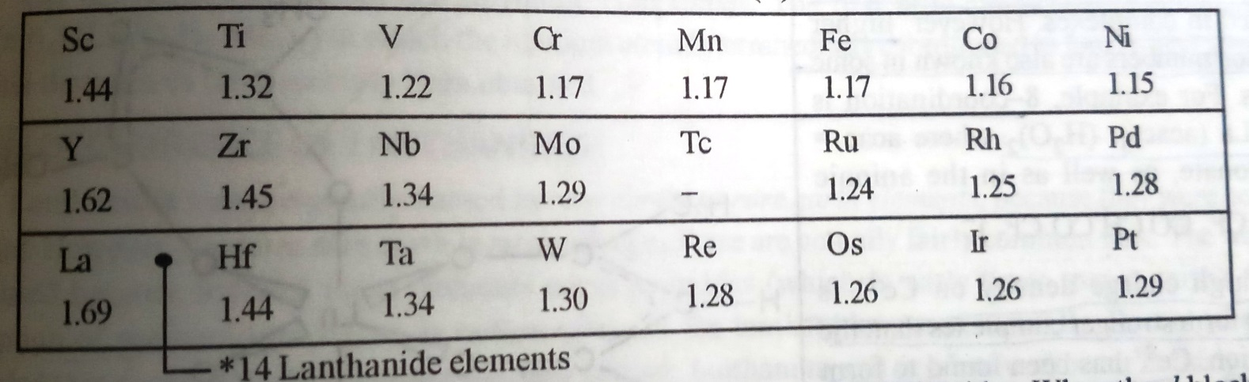
Cause of Lanthanide contraction
Electrons in f-orbitals repel one another very weakly because the lobes of f-orbitals are far apart from each other.
Poor shielding effect of f-electrons shielding of electrons decreases in the order s>p>d>f. Thus, the effective nuclear charge increases with the increase in atomic number of lanthanides. This increase the inward pull of the 4f electrons and results in the reduction of the size of the atom or ion.
This contraction in the size of the atom or ion by pulling the valence electrons inward due to high nuclear charge and the poor shielding effect of the f-electron is the main cause of lanthanide contraction.
Table: Atomic radii of the elements before and after lanthanides
As a result of lanthanide contraction, the chemistry of 2nd and 3rd transition series resemble each other than the elements of 1st and 2nd transition series.

Slide 15
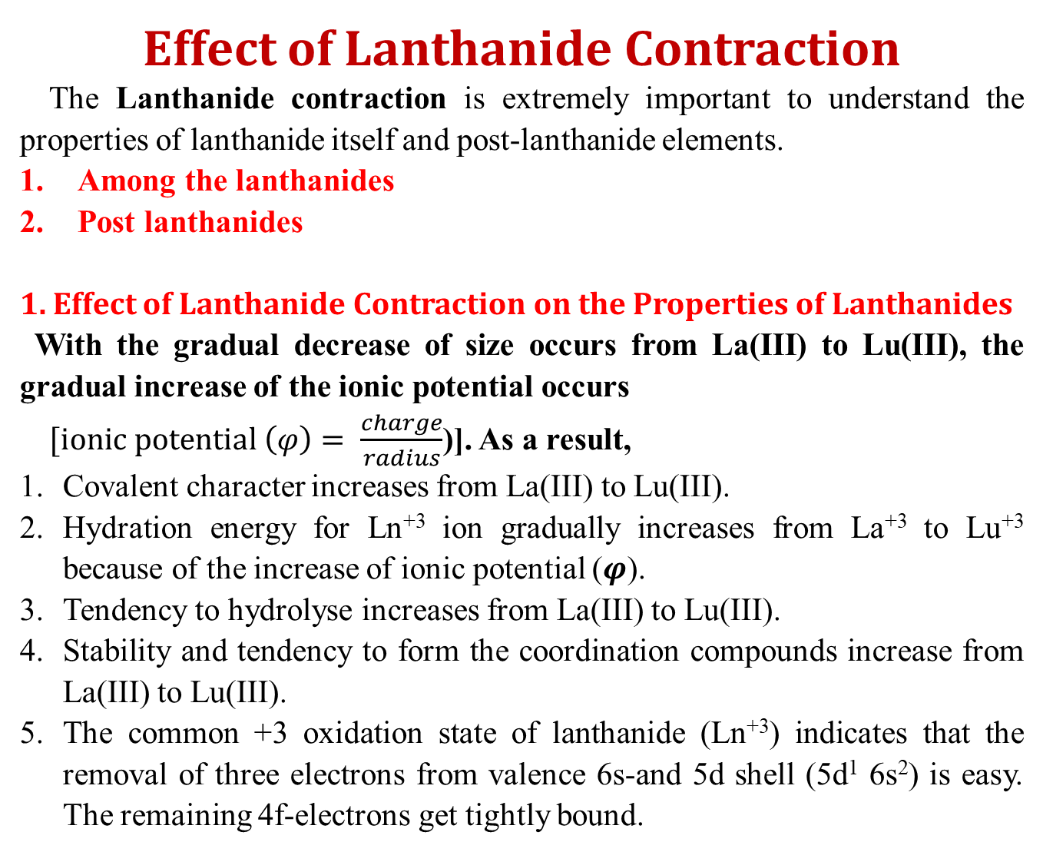
Effect of Lanthanide Contraction
The Lanthanide contraction is extremely important to understand the properties of lanthanide itself and post-lanthanide elements.
Among the lanthanides
Post lanthanides
1. Effect of Lanthanide Contraction on the Properties of Lanthanides
With the gradual decrease of size occurs from La(III) to Lu(III), the gradual increase of the ionic potential occurs
$[ionic potential \left(φ\right)= \frac{charge}{radius}$)]. As a result,
Covalent character increases from La(III) to Lu(III).
Hydration energy for Ln⁺³ ion gradually increases from La⁺³ to Lu⁺³ because of the increase of ionic potential ($φ$).
Tendency to hydrolyse increases from La(III) to Lu(III).
Stability and tendency to form the coordination compounds increase from La(III) to Lu(III).
The common +3 oxidation state of lanthanide (Ln⁺³) indicates that the removal of three electrons from valence 6s-and 5d shell (5d¹ 6s²) is easy. The remaining 4f-electrons get tightly bound.

Slide 17
Effect of Lanthanide Contraction
6. Acidity of the oxides increases from La₂O₃ to Lu₂O₃
7. Thermal stability of the oxy salts (e.g. carbonates, sulphates, etc.) decreases from La(III) to Lu(III).
8. Crystallographic radii decrease from La⁺³ to Lu⁺³ while their hydrated radii follow the opposite order because the smaller Ln⁺³ ions are hydrated better for their higher charge/radius ratio.
9. Summation of fast three ionisation energy (I₁ + I₂ + I₃) gradually increases from La to Lu with two significant peaks at Eu and Yb which represent the loss of an electron from the stable half-filled 4f⁷ and full filled 4f¹⁴ levels, respectively.
10. Effect on the basic strength of hydroxides: The ionic size of the lanthanide series gradually decreases from La ³⁺ to Lu ³⁺ for lanthanide contraction. As a result, according to Fajan’s rule, the covalent characteristics of lanthanide metal hydroxide complexes steadily rise from lanthanum to lutetium. Lu (OH)₃ is therefore more covalent than La (OH)₃. The basic strength of lanthanide metal hydroxide decreases from La ³⁺ to Lu ³⁺. Thus La (OH)₃ is the most basic whereas Lu (OH)₃ is the least basic.

Slide 18
Effect of Lanthanide Contraction
2. Low Atomic and Ionic Radii of the Post-lanthanide Elements
The same group elements in the 4d series and the 5d series are nearly the same size due to relativistic effects and lanthanide contraction. Along a group from top to bottom, the size increases as the principal quantum number increases. Generally, s- and p-block elements follow this trend. However, the elements of a specific group of the 4d and 5d series are nearly equal in size. As a result, the sizes of the elements in each pair: Zr and Hf; Nb and Ta; Tc and Re; Ag and Au; and Cd and Hg become almost identical. This happens so for the lanthanide contraction to the postlanthanides.

Slide 19
Effect of Lanthanide Contraction
2. Low Atomic and Ionic Radii of the Post-lanthanide Elements
metallic radii in pm & () = covalent radii in pm
Group & Period | 3 | 4 | 5 | 6 | 7 | 8 | 9 | 10 | 11 | 12
3d | Sc 164 (144) | Ti 147 (132) | V 134 (122) | Cr | Mn 137 (117) | Fe | Co | Ni | Cu 128 (117) | Zn 137 (125)
4d | Y 182 (162) | Zr 167 (145) | Nb 147 (134) | Mo | Tc 135 | Ru | Rh | Pd | Ag 144 (134) | Cd 152 (141)
5d | La 188 (169) | Hf 159 (144) | Ta 147 (134) | W | Re 137 (128) | Os | Ir | Pt | Au 144 (134) | Hg 153 (144)

Slide 20
Effect of Lanthanide Contraction
3. Similarity of Chemical Properties Between the Elements of the Same Group of 4d and 5d Series
The size of the elements in the same group of 4d and 5d series are almost same for lanthanide contraction. Since the chemical and physical properties of the elements are largely governed by the ionic potential (charge/radius). The chemical and physical properties become almost identical for the members of 4d and 5d in the same group. For example, the chemical properties of the following pairs are similar: Zr and Hf; Nb and Ta; Tc and Re; Ag and Au; Cd and Hg etc. They are so similar in their chemical behavior that it is a very difficult task to separate them chemically. Because of the same ground, Zr and Hf occur naturally in the same source. The same thing also happens for the other pairs.

Slide 21
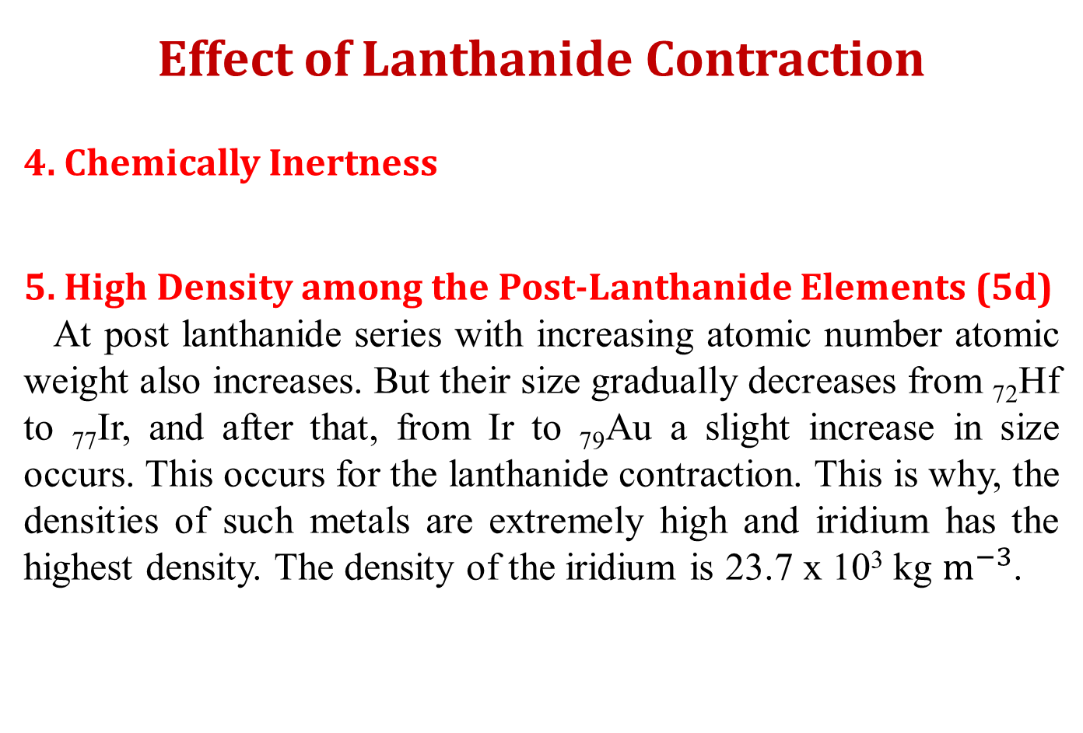
Effect of Lanthanide Contraction
4. Chemically Inertness
5. High Density among the Post-Lanthanide Elements (5d)
At post lanthanide series with increasing atomic number atomic weight also increases. But their size gradually decreases from ₇₂Hf to ₇₇Ir, and after that, from Ir to ₇₉Au a slight increase in size occurs. This occurs for the lanthanide contraction. This is why, the densities of such metals are extremely high and iridium has the highest density. The density of the iridium is 23.7 x 10³ kg $m^{−3}$.

Slide 22
Effect of Lanthanide Contraction
6. Ionization Energy and Electronegativity
Among the post lanthanides elements with increasing atomic number (Z) size of the element decreases as a consequence of Lanthanide contraction. As a result, effective nuclear charge (Z_{eff}) increases with increasing atomic number. Therefore, ionization energy increases with increasing atomic number. The ionization energy of 5d elements is substantially higher than that of 4d and 3d. Gold and iridium have the highest ionization energy. As a result, they become less chemically reactive. For instance, the sixth-period elements, such as platinum (Pt), gold (Au), mercury (Hg), etc. have very low chemical reactivity. Therefore, these metals become noble. Electronegativity also increases from La to Lu.

Slide 23
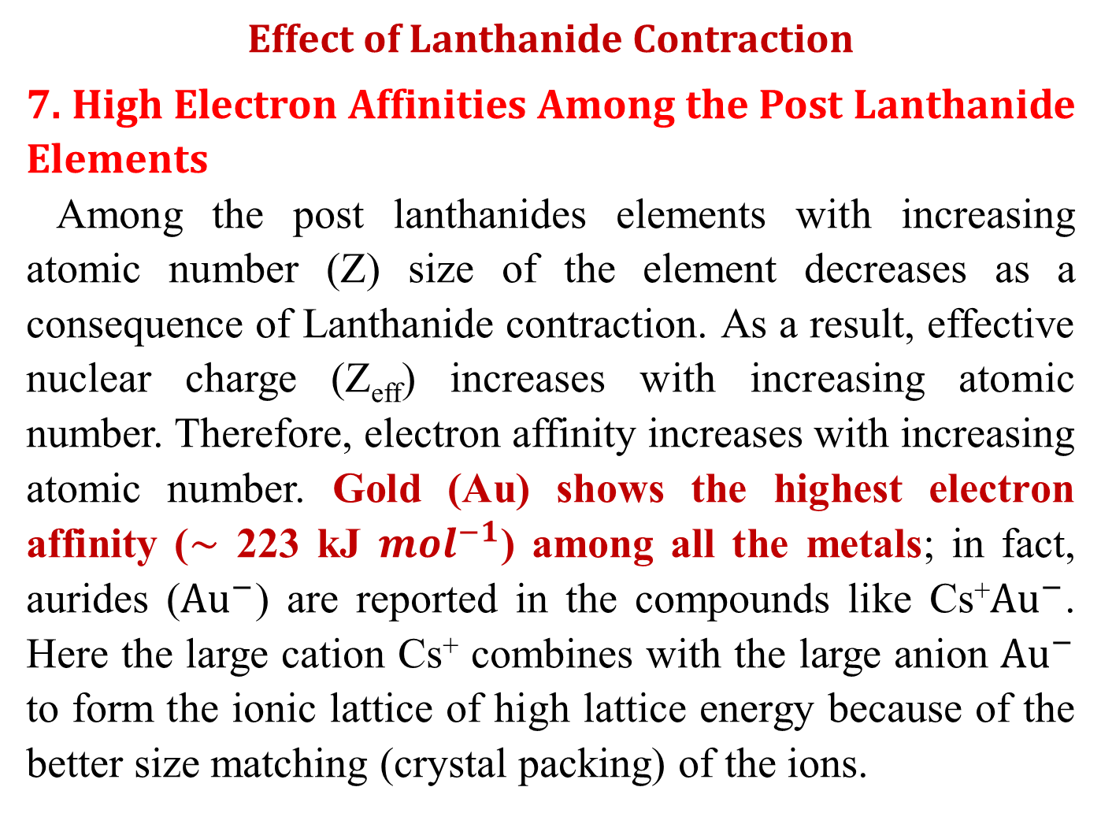
Effect of Lanthanide Contraction
7. High Electron Affinities Among the Post Lanthanide Elements
Among the post lanthanides elements with increasing atomic number (Z) size of the element decreases as a consequence of Lanthanide contraction. As a result, effective nuclear charge (Z_{eff}) increases with increasing atomic number. Therefore, electron affinity increases with increasing atomic number. Gold (Au) shows the highest electron affinity ($\sim$ 223 kJ ${mol}^{−1}$) among all the metals; in fact, aurides (${Au}^{−}$) are reported in the compounds like Cs⁺${Au}^{−}$. Here the large cation Cs⁺ combines with the large anion ${Au}^{−}$ to form the ionic lattice of high lattice energy because of the better size matching (crystal packing) of the ions.

Slide 24
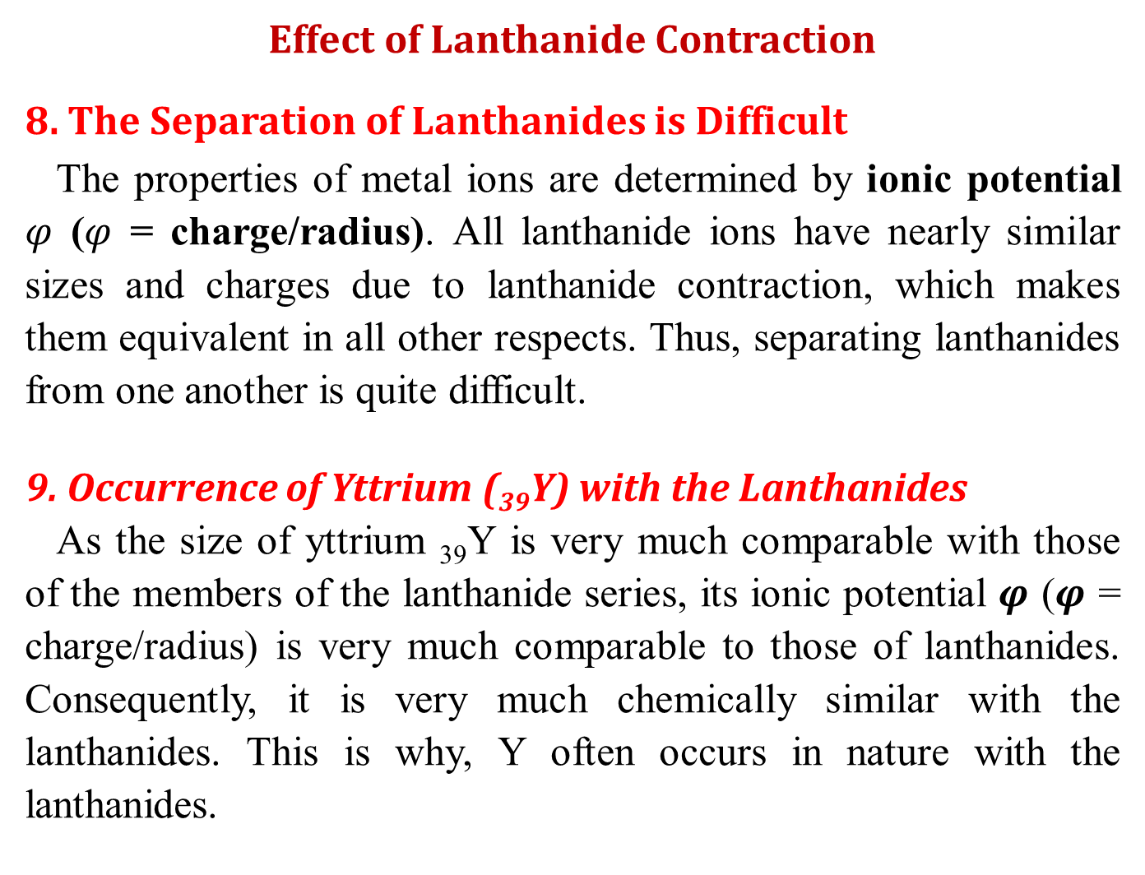
Effect of Lanthanide Contraction
8. The Separation of Lanthanides is Difficult
The properties of metal ions are determined by ionic potential $φ$ ($φ$ = charge/radius). All lanthanide ions have nearly similar sizes and charges due to lanthanide contraction, which makes them equivalent in all other respects. Thus, separating lanthanides from one another is quite difficult.
9. Occurrence of Yttrium (₃₉Y) with the Lanthanides
As the size of yttrium ₃₉Y is very much comparable with those of the members of the lanthanide series, its ionic potential $φ$ ($φ$ = charge/radius) is very much comparable to those of lanthanides. Consequently, it is very much chemically similar with the lanthanides. This is why, Y often occurs in nature with the lanthanides.

Slide 25
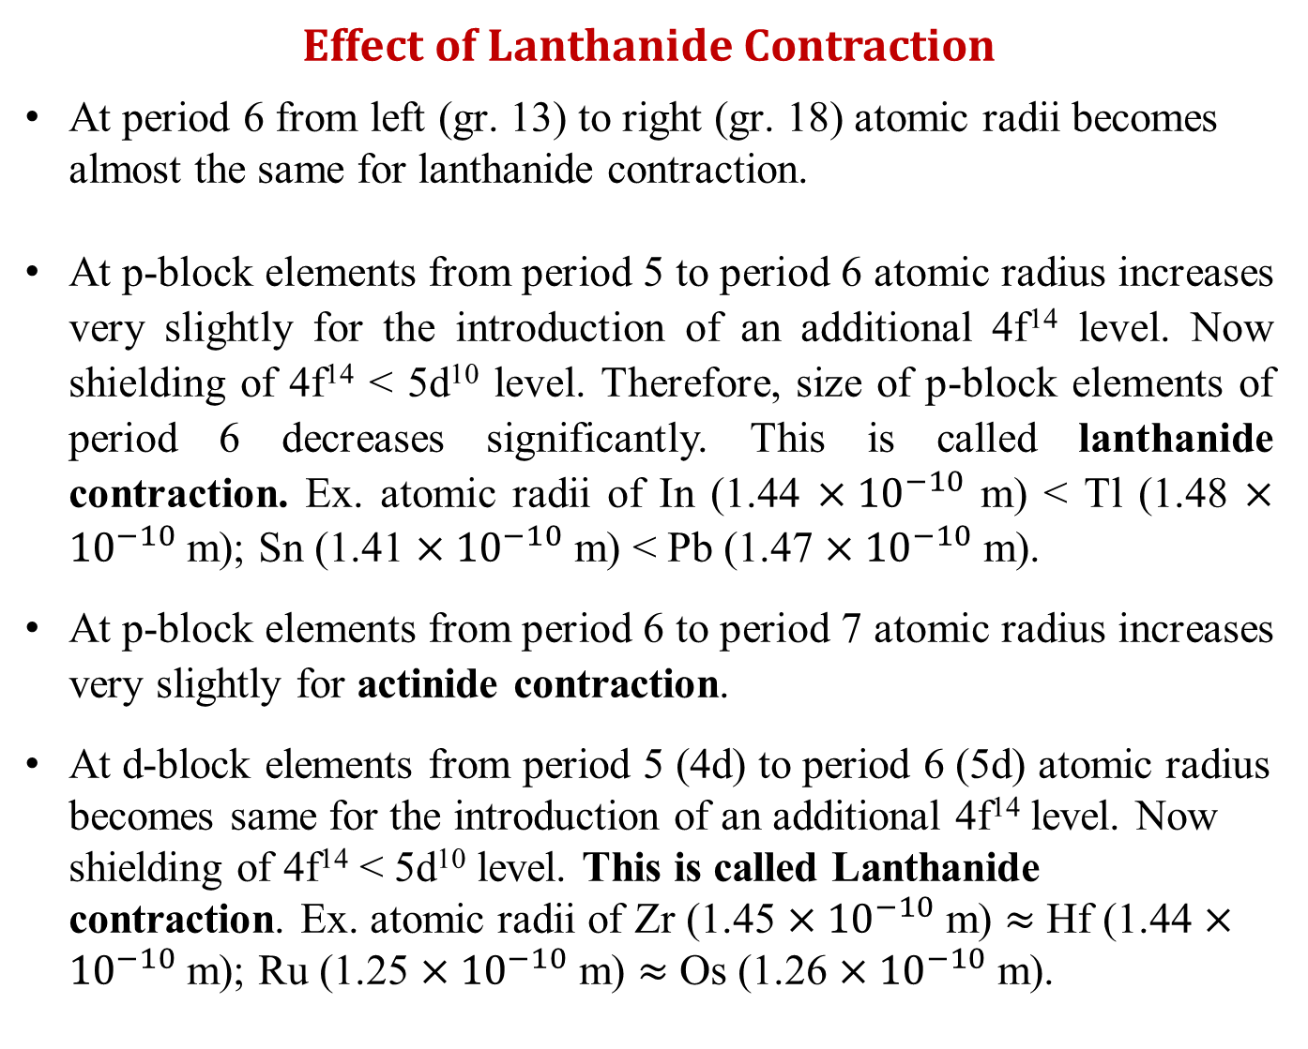
Effect of Lanthanide Contraction
At period 6 from left (gr. 13) to right (gr. 18) atomic radii becomes almost the same for lanthanide contraction.
At p-block elements from period 5 to period 6 atomic radius increases very slightly for the introduction of an additional 4f¹⁴ level. Now shielding of 4f¹⁴ < 5d¹⁰ level. Therefore, size of p-block elements of period 6 decreases significantly. This is called lanthanide contraction. Ex. atomic radii of In (1.44 $×{10}^{−10}$ m) < Tl (1.48 $×{10}^{−10}$ m); Sn (1.41 $×{10}^{−10}$ m) < Pb (1.47 $×{10}^{−10}$ m).
At p-block elements from period 6 to period 7 atomic radius increases very slightly for actinide contraction.
At d-block elements from period 5 (4d) to period 6 (5d) atomic radius becomes same for the introduction of an additional 4f¹⁴ level. Now shielding of 4f¹⁴ < 5d¹⁰ level. This is called Lanthanide contraction. Ex. atomic radii of Zr (1.45 $×{10}^{−10}$ m) $≈$ Hf (1.44 $×{10}^{−10}$ m); Ru (1.25 $×{10}^{−10}$ m) $≈$ Os (1.26 $×{10}^{−10}$ m).

Slide 26
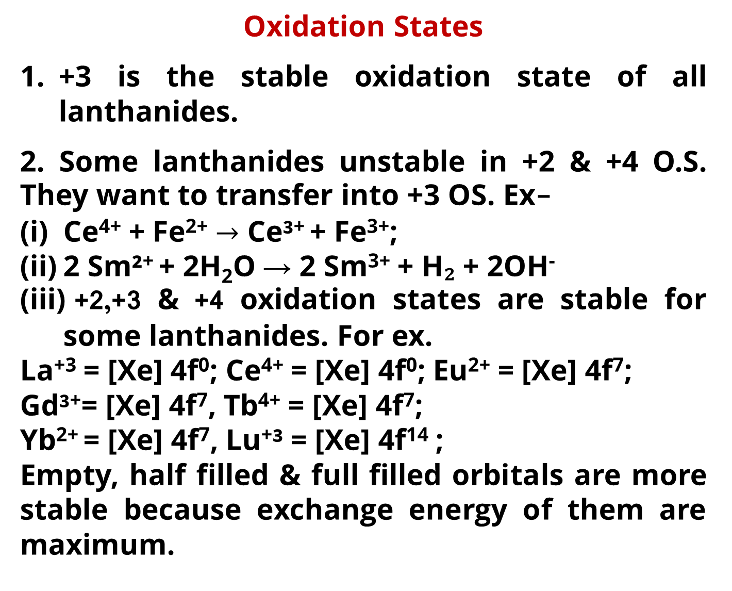
Oxidation States
+3 is the stable oxidation state of all lanthanides.
2. Some lanthanides unstable in +2 & +4 O.S. They want to transfer into +3 OS. Ex-
Ce⁴⁺ + Fe²⁺ $→$ Ce³⁺ + Fe³⁺;
2 Sm²⁺ + 2H₂O → 2 Sm³⁺ + H₂ + 2OH⁻
+2,+3 & +4 oxidation states are stable for some lanthanides. For ex.
La⁺³ = [Xe] 4f⁰; Ce⁴⁺ = [Xe] 4f⁰; Eu²⁺ = [Xe] 4f⁷;
Gd³⁺= [Xe] 4f⁷, Tb⁴⁺ = [Xe] 4f⁷;
Yb²⁺ = [Xe] 4f⁷, Lu⁺³ = [Xe] 4f¹⁴ ;
Empty, half filled & full filled orbitals are more stable because exchange energy of them are maximum.

Slide 27
Oxidation States
3. For some lanthanides +2, +3 and +4 O.S. are stable though they are not empty pr half filled or full filled. For ex. Ce³⁺ = [Xe] 4f¹; Pr⁴⁺ = [Xe] 4f^{1 ;}
Ce²⁺ = [Xe] 4f² ; Pr³⁺ = [Xe] 4f²;
Nd⁴⁺ = [Xe] 4f²; Sm²⁺ = [Xe] 4f⁶
Dy²⁺ = [Xe]4f¹⁰; Tm²⁺ [Xe] 4f¹³
The stability of these ions can be explained by kinetic & Thermodynamic factors.
Oxide compounds of প্র্যাসিওডিমিয়াম (Pr), নিওডিমিয়াম (Nd), টারবিয়াম (Tb), ডিসপ্রোসিয়াম (Dy) shows +4 O.S.
 | La | Ce | Pr | Nd | Pm | Sm | Eu | Gd | Tb | Dy | Ho | Er | Tm | Yb | Lu
 | +3 | +3, +4 | +3, +4 | +3, +4 | +3 | +2, +3 | +2, +3 | +3 | +3, +4 | +3, +4 | +3 | +3 | +3 | +2, +3 | +3

Slide 28
Oxidation States
The configuration of La³⁺ ion, is that of xenon which is highly stable. So, it is not possible to have a La⁺⁴ ion.
In the same way Ga, Lu also form only +3 ions, because the removal of three electrons give stable half filled 4f⁷ configuration for Gd³⁺ ion and in completely filled 4f¹⁴ configuration for Lu³⁺ ions.
In other Lanthanides, +2 and +4 oxidations states also occur but these are always less table than the +3 oxidation state which is characteristic of this family.
The +2 and +4 oxidation states are shown by those elements which will attain f⁰, f7 and f14 configurations by doing so
For eg Ce⁴⁺& Eu²⁺: 4f⁷, Tb: f⁷, Yb²⁺: 4f¹⁴extra stability is associated with f⁰, f⁷, f¹⁴ configurations.

Slide 29
Symbol | Idealized | Observed | M³⁺ | M²⁺ | M⁴⁺ | At Radii A* | No of f electrons
La | [Xe]6s² 4f⁰ 5d¹ | [Xe]6s² 4f⁰ 5d¹ | [Xe] | - |  | 1.88 | 0
Ce | [Xe]6s² 4f¹ 5d¹ | [Xe]6s² 4f² 5d⁰ | 4f¹ | 4f² | [Xe] | 1.82 | 1
Pr | [Xe]6s² 4f² 5d¹ | [Xe]6s² 4f³ 5d⁰ | 4f² | - | 4f¹ | 1.83 | 2
Nd | [Xe]6s² 4f³ 5d¹ | [Xe]6s² 4f⁴ 5d⁰ | 4f³ | 4f⁴ | 4f² | 1.82 | 3
Pm | [Xe]6s² 4f⁴ 5d¹ | [Xe]6s² 4f⁵ 5d⁰ | 4f⁴ | - | - |  | 4
Sm | [Xe]6s² 4f⁶ 5d⁰ | [Xe]6s² 4f⁶ 5d⁰ | 4f⁵ | 4f⁶ | - | 1.80 | 5
Eu | [Xe]6s² 4f⁷ 5d⁰ | [Xe]6s² 4f⁷ 5d⁰ | 4f⁶ | 4f⁷ | - | 2.04 | 6
Gd | [Xe]6s² 4f⁷ 5d¹ | [Xe]6s² 4f⁷ 5d¹ | 4f⁷ | - | - | 1.80 | 7
Tb | [Xe]6s² 4f⁸ 5d¹ | [Xe]6s² 4f⁹ 5d⁰ | 4f⁸ | - | 4f⁷ | 1.78 | 8
Dy | [Xe]6s² 4f⁹ 5d¹ | [Xe]6s² 4f¹⁰ 5d⁰ | 4f⁹ | - | 4f⁸ | 1.77 | 9
Ho | [Xe]6s² 4f¹⁰ 5d¹ | [Xe]6s² 4f¹¹ 5d⁰ | 4f¹⁰ | - | - | 1.77 | 10
Er | [Xe]6s² 4f¹¹ 5d¹ | [Xe]6s² 4f¹² 5d⁰ | 4f¹¹ | - | - | 1.76 | 11
Tm | [Xe]6s² 4f¹² 5d¹ | [Xe]6s² 4f¹³ 5d⁰ | 4f¹² | 4f¹³ | - | 1.75 | 12
Yb | [Xe]6s² 4f¹³ 5d¹ | [Xe]6s² 4f¹⁴ 5d⁰ | 4f¹³ | 4f¹⁴ | - | 1.94 | 13
Lu | [Xe]6s² 4f¹⁴ 5d¹ | [Xe]6s² 4f¹⁴ 5d¹ | 4f¹⁴ | - | - | 1.73 | 14

Slide 30
Table: Colour of Lanthanide, Ln³⁺ ion
The colour of lanthanides originate from f-f transition
F-f transition are much weaker & narrower than d-d transition
This makes the colour of lanthanide conplexes far fainter than transition complexes.

Slide 31
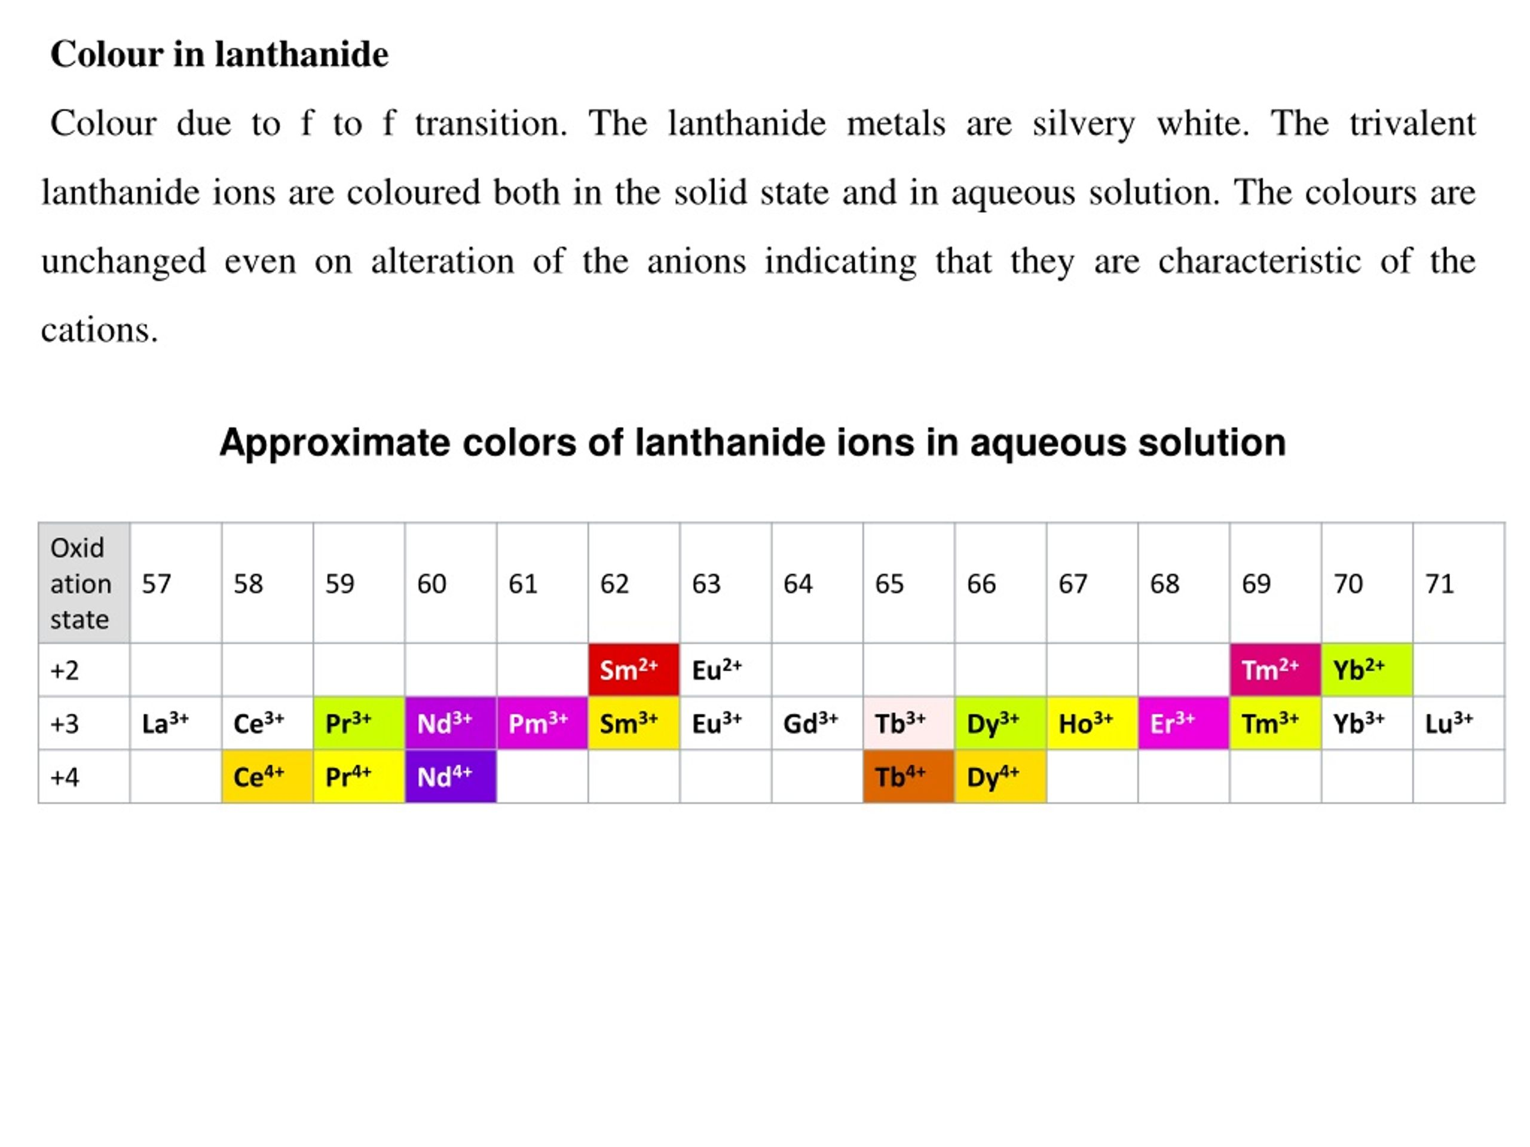
Table: Colour of Lanthanide, Ln³⁺ ion

Slide 32
Table: Colour of Lanthanide, Ln³⁺ ion
The lanthanide metals are silvery white but the trivalent lanthanide ions show different colours. Colour of the ions depends on the number of unpaired electrons because the elements with If electrons often have a similar colour to those of (14-x) f'electrons. This is evident from the following Table. The colour of lanthanide ions is due to the presence of partly filled f-orbitals. As a result it is possible to absorb certain wavelength from the visible region of the spectrum. This results in transition from one 4f orbital to another 4f orbital known as f-f transition. The colour transmitted is the colour shown by the substance.

Slide 33
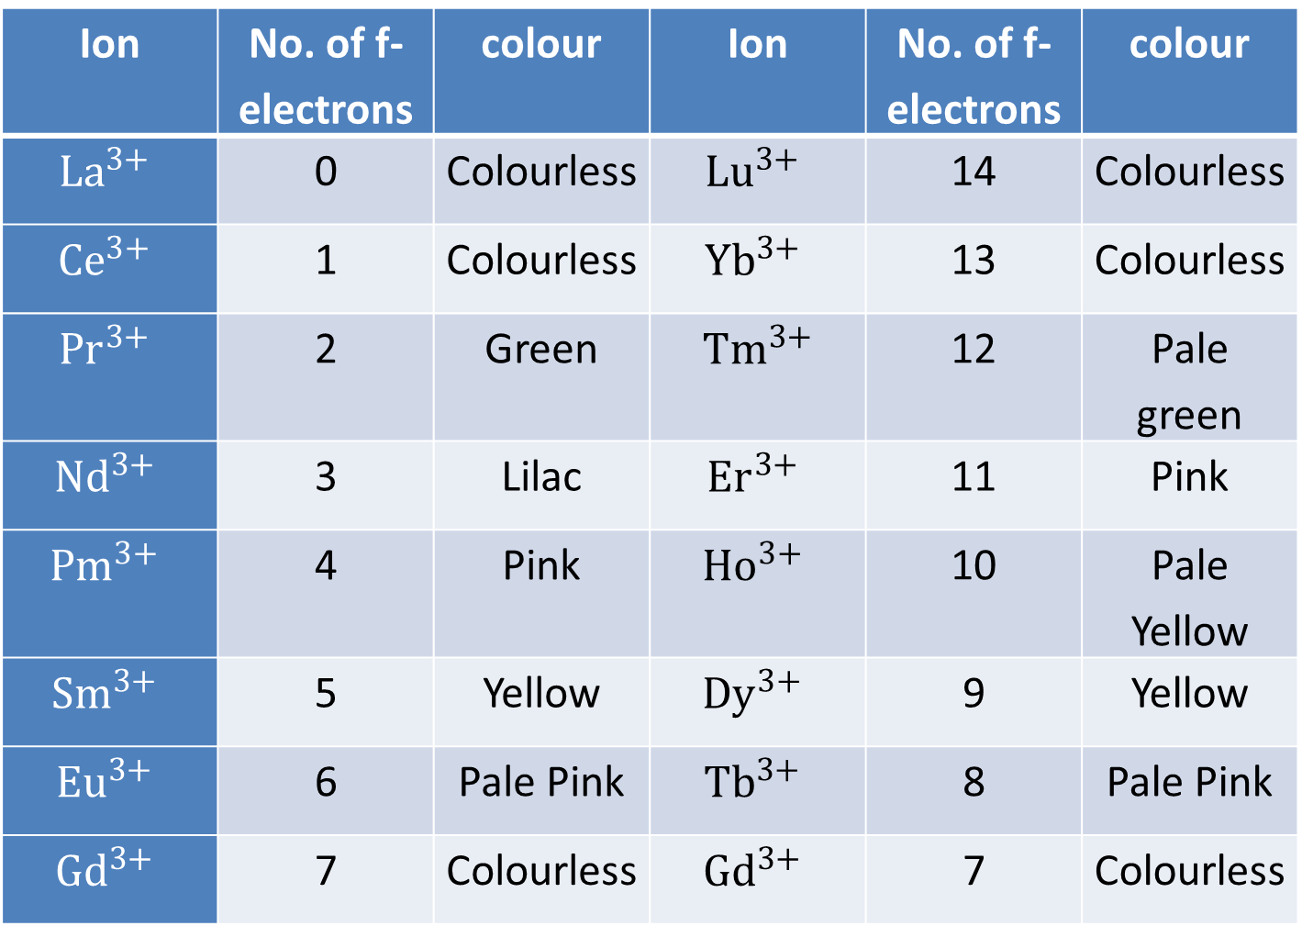
Table: Colour of Lanthanide, Ln³⁺ ion
Ion | No. of f-electrons | colour | Ion | No. of f-electrons | colour
$${La}^{3+}$$ | 0 | Colourless | $${Lu}^{3+}$$ | 14 | Colourless
$${Ce}^{3+}$$ | 1 | Colourless | $${Yb}^{3+}$$ | 13 | Colourless
$${Pr}^{3+}$$ | 2 | Green | $${Tm}^{3+}$$ | 12 | Pale green
$${Nd}^{3+}$$ | 3 | Lilac | $${Er}^{3+}$$ | 11 | Pink
$${Pm}^{3+}$$ | 4 | Pink | $${Ho}^{3+}$$ | 10 | Pale Yellow
$${Sm}^{3+}$$ | 5 | Yellow | $${Dy}^{3+}$$ | 9 | Yellow
$${Eu}^{3+}$$ | 6 | Pale Pink | $${Tb}^{3+}$$ | 8 | Pale Pink
$${Gd}^{3+}$$ | 7 | Colourless | $${Gd}^{3+}$$ | 7 | Colourless

Slide 34
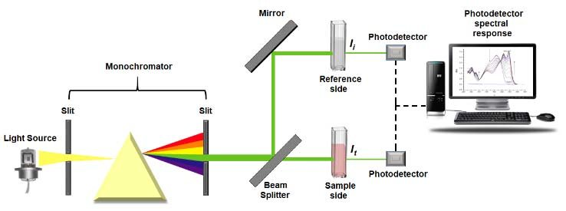
Double beam UV-Visible Spectro photometer

Slide 35
SPECTRAL PROPERTIES OF LANTHANIDE
The absorption spectra of the compounds of trivalent lanthanide ions show very sharp line like bands in the ultraviolet, visible or near infrared regions. These sharp bands obtained as a result of transitions in the partly filled 4f subshell electrons are known as f-f transitions. The bands of lanthanide ions are so sharp that they are very useful for characterising the lanthanides and for their quantitative estimations.Since 4f orbitals lie deep in the atoms of these elements, therefore they are shielded from by agents. Thus the complexing

Slide 36
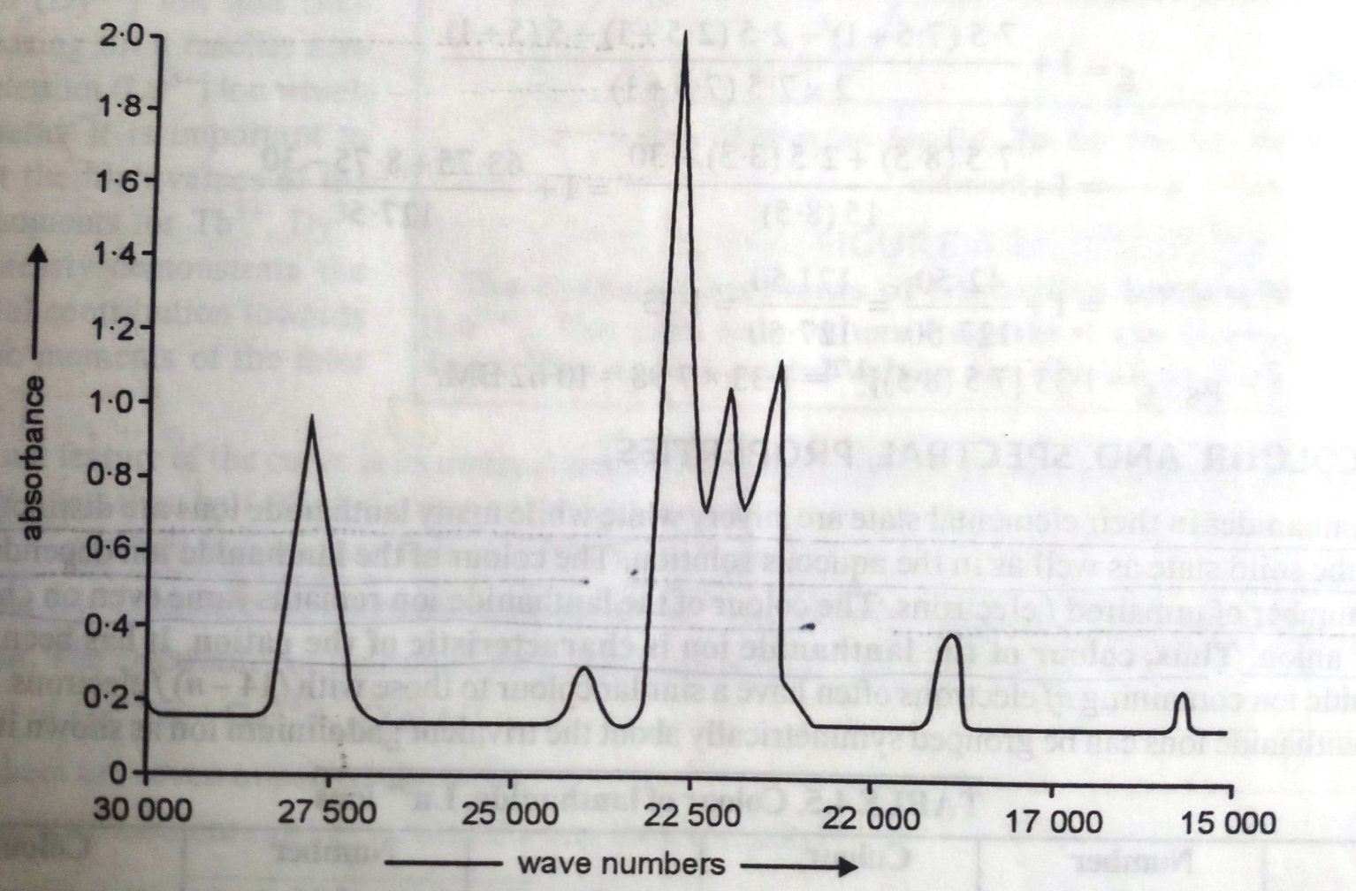
SPECTRAL PROPERTIES OF LANTHANIDE
Fig. UV-Vis spectrum of Ho³⁺ ion

Slide 37
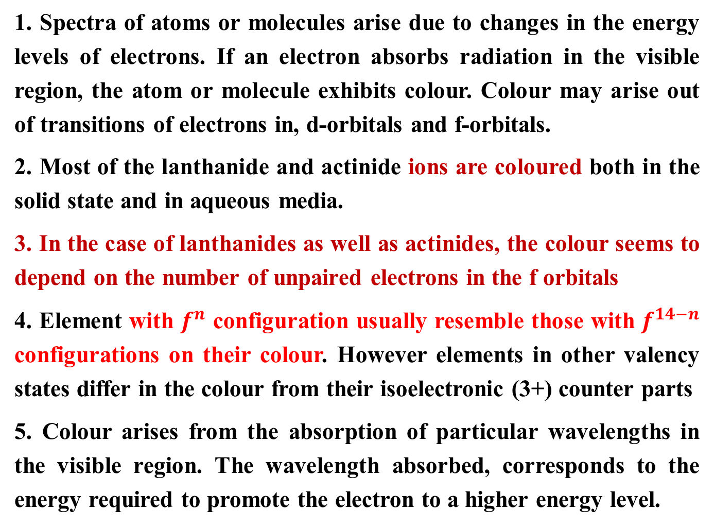
COLOUR AND SPECTRAL PROPERTIES
1. Spectra of atoms or molecules arise due to changes in the energy levels of electrons. If an electron absorbs radiation in the visible region, the atom or molecule exhibits colour. Colour may arise out of transitions of electrons in, d-orbitals and f-orbitals.
2. Most of the lanthanide and actinide ions are coloured both in the solid state and in aqueous media.
3. In the case of lanthanides as well as actinides, the colour seems to depend on the number of unpaired electrons in the f orbitals
4. Element with $f^{n}$ configuration usually resemble those with $f^{14−n}$ configurations on their colour. However elements in other valency states differ in the colour from their isoelectronic (3+) counter parts
5. Colour arises from the absorption of particular wavelengths in the visible region. The wavelength absorbed, corresponds to the energy required to promote the electron to a higher energy level.

Slide 38
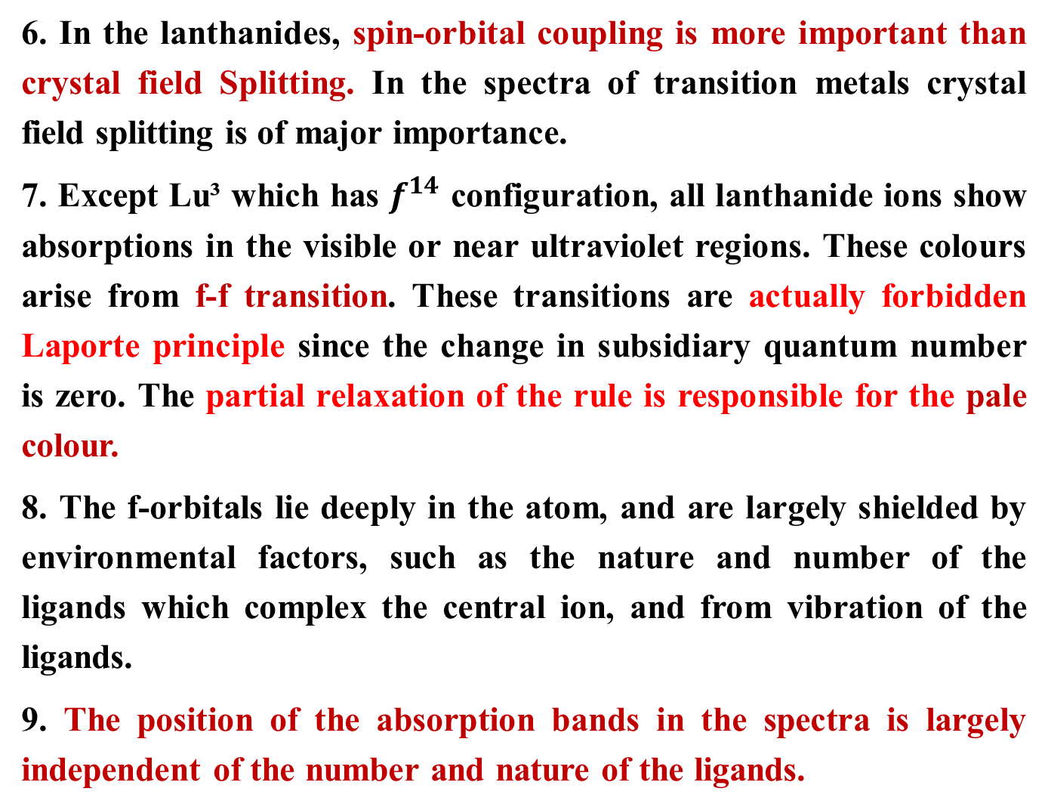
COLOUR AND SPECTRAL PROPERTIES
6. In the lanthanides, spin-orbital coupling is more important than crystal field Splitting. In the spectra of transition metals crystal field splitting is of major importance.
7. Except Lu³ which has $f^{14}$ configuration, all lanthanide ions show absorptions in the visible or near ultraviolet regions. These colours arise from f-f transition. These transitions are actually forbidden Laporte principle since the change in subsidiary quantum number is zero. The partial relaxation of the rule is responsible for the pale colour.
8. The f-orbitals lie deeply in the atom, and are largely shielded by environmental factors, such as the nature and number of the ligands which complex the central ion, and from vibration of the ligands.
9. The position of the absorption bands in the spectra is largely independent of the number and nature of the ligands.

Slide 39
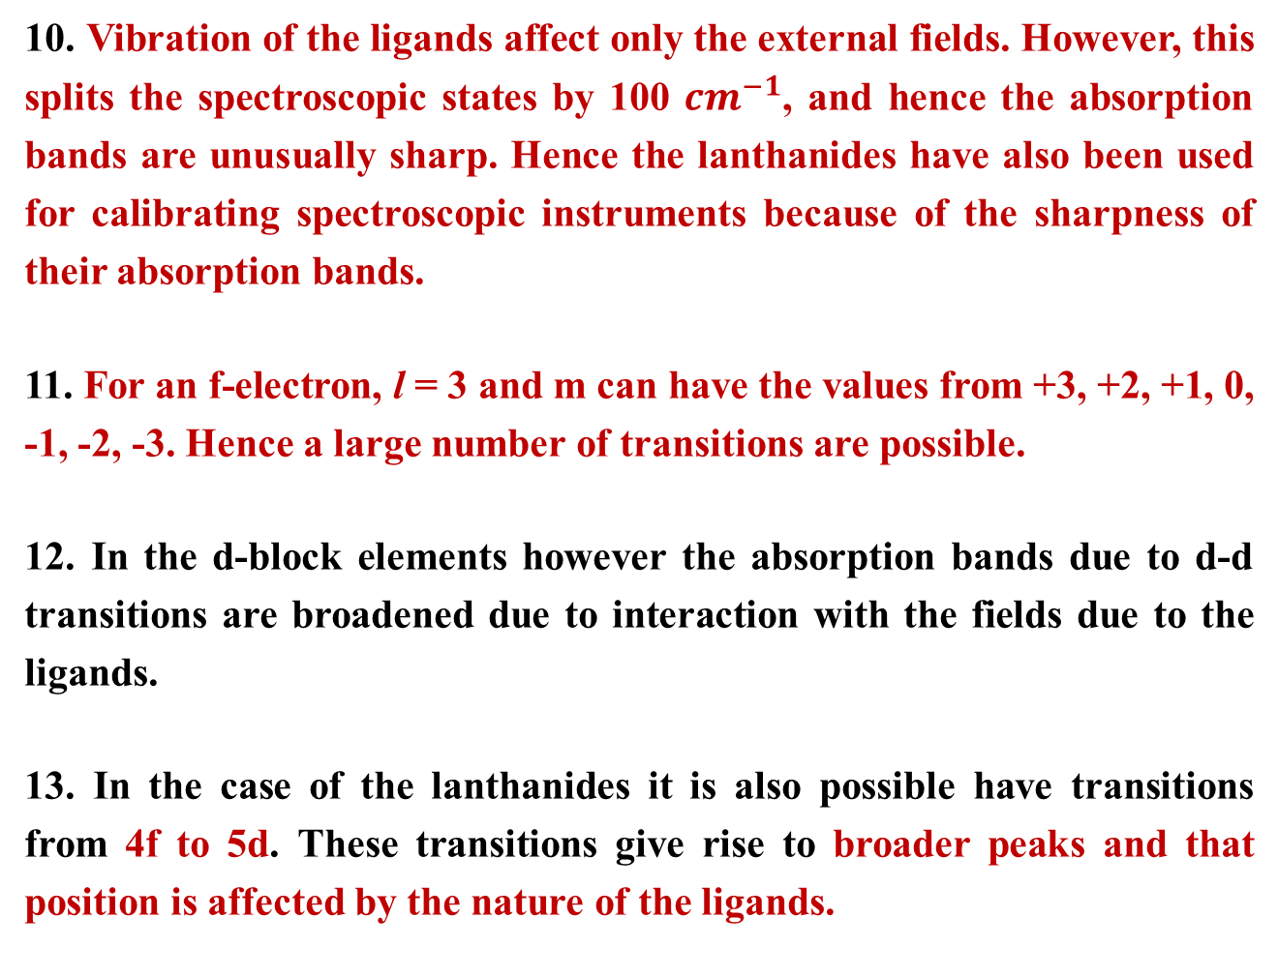
COLOUR AND SPECTRAL PROPERTIES
10. Vibration of the ligands affect only the external fields. However, this splits the spectroscopic states by 100 ${cm}^{−1}$, and hence the absorption bands are unusually sharp. Hence the lanthanides have also been used for calibrating spectroscopic instruments because of the sharpness of their absorption bands.
11. For an f-electron, l = 3 and m can have the values from +3, +2, +1, 0, -1, -2, -3. Hence a large number of transitions are possible.
12. In the d-block elements however the absorption bands due to d-d transitions are broadened due to interaction with the fields due to the ligands.
13. In the case of the lanthanides it is also possible have transitions from 4f to 5d. These transitions give rise to broader peaks and that position is affected by the nature of the ligands.

Slide 40
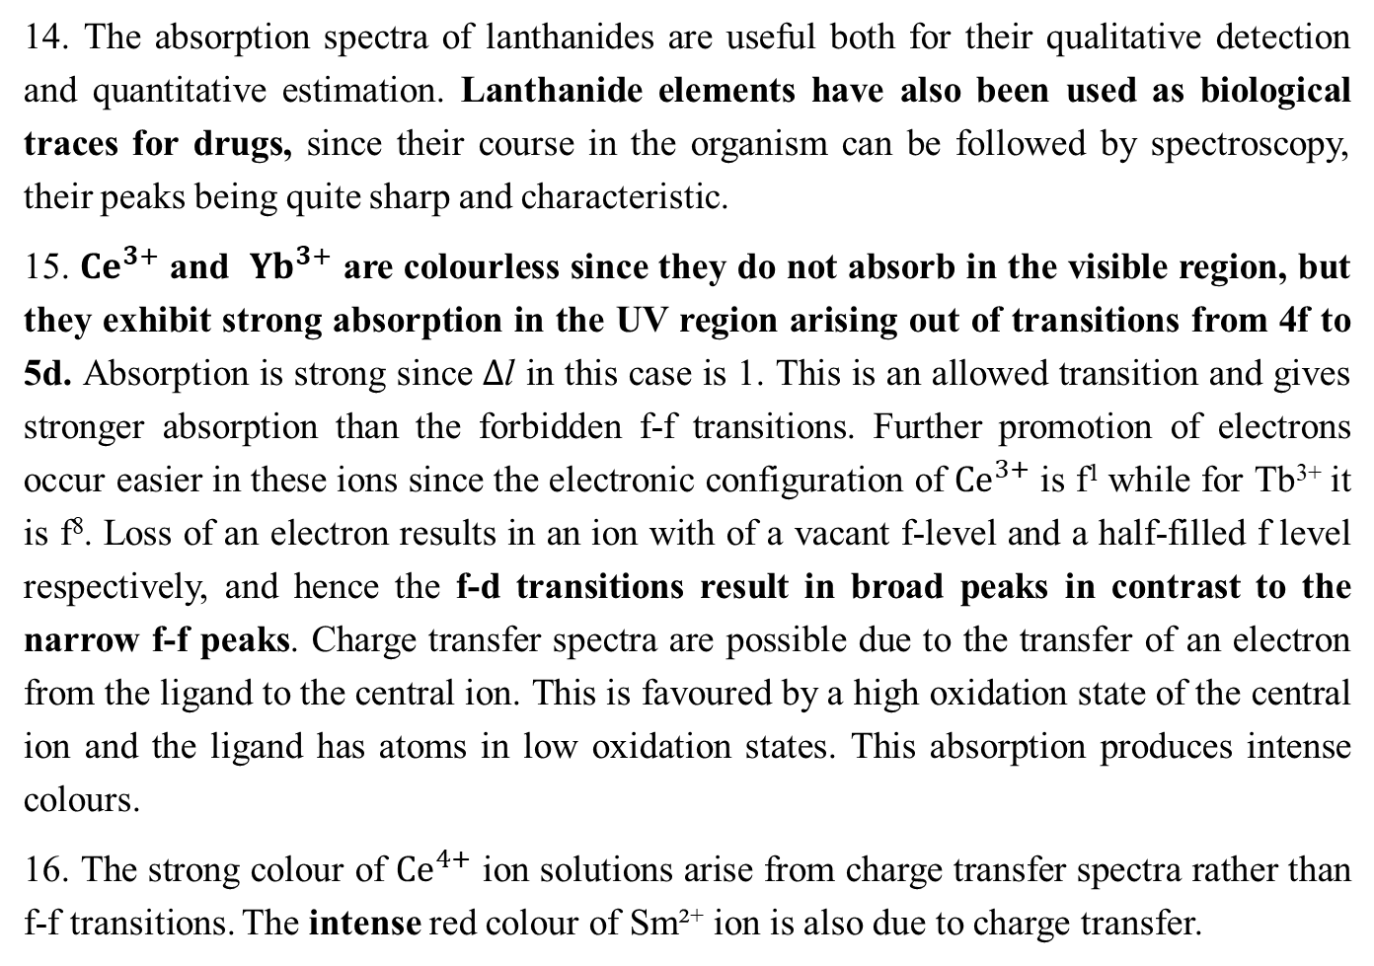
COLOUR AND SPECTRAL PROPERTIES
14. The absorption spectra of lanthanides are useful both for their qualitative detection and quantitative estimation. Lanthanide elements have also been used as biological traces for drugs, since their course in the organism can be followed by spectroscopy, their peaks being quite sharp and characteristic.
15. ${Ce}^{3+}$ and ${Yb}^{3+}$ are colourless since they do not absorb in the visible region, but they exhibit strong absorption in the UV region arising out of transitions from 4f to 5d. Absorption is strong since $∆$l in this case is 1. This is an allowed transition and gives stronger absorption than the forbidden f-f transitions. Further promotion of electrons occur easier in these ions since the electronic configuration of ${Ce}^{3+}$ is f¹ while for Tb³⁺ it is f⁸. Loss of an electron results in an ion with of a vacant f-level and a half-filled f level respectively, and hence the f-d transitions result in broad peaks in contrast to the narrow f-f peaks. Charge transfer spectra are possible due to the transfer of an electron from the ligand to the central ion. This is favoured by a high oxidation state of the central ion and the ligand has atoms in low oxidation states. This absorption produces intense colours.
16. The strong colour of ${Ce}^{4+}$ ion solutions arise from charge transfer spectra rather than f-f transitions. The intense red colour of Sm²⁺ ion is also due to charge transfer.

Slide 41
COLOUR AND SPECTRAL PROPERTIES
The colour of lanthanide ion depends on the number of unpaired f electrons.
Lanthanide ion containing nf electrons often have a similar colour to those with
(14-n)f electrons.
The colour of the lanthanide ion is due to the absorption of light from the visible region of the spectrum that results in the electronic transition within the 4f-level. This type of transition is called f-f transition.
The f-f absorption of lanthanides ions have low intensity because these transition are not allowed.
Sometimes, the colour of the lanthanide ion is due to f-d transition, f-d transition is allowed, thus, they show very intense absorption bands. Example: Ce³⁺ and Tb³⁺ show very intense f-d absorption band.
Transition due to f-d bands are broad in contrast to narrow f-f bands.
The colour of some of the lanthanide ions is due to charge transfer. This transfer of charge occurs from the ligand to the metal, when the metal is in high oxidation state or the ligand has strong reducing properties. Charge transfer usually produce intense colours. Eg. Strong yellow colour of Ce⁴⁺ solutions arises due to charge transfer. The blood red colour of Sm²⁺ is also due to charge transfer.

Slide 42
UNIQUE FEATURE OF SPECTRA OF TRIPOSITIVE LANTHANIDES IONS
In the case of lanthanide ions, the absorption bands are sharp line like bands in the UV, Visible or near IR regions.
The bands of lanthanide ions are very sharp that they are used for characterizing lanthanides.
The reason for very sharp absorption band is that the 4f orbitals are located deep inside the atom. Thus, they are effectively shielded from environment factors such as the nature and number of ligands which form the complexes, and from vibrations of the liagands. Thus, the colour of lanthanide ion does not change with different ligands, it shows little dependence on the nature of ligand.
In contrast with transition elements, d-d transition give absorption bands whose position changes from ligand to ligand, and width of the peak is greatly broadened because of the vibrations of the ligands.

Slide 43
Complexes -Lanthanides are moderate in their complex forming ability which increases to the right . Although tri-positive cations have a high charge equal to +3 on them, their size is so large, their charge to radius ratio becomes so small that these ions have less tendency to form complexes, e.g.: Stable complexes are known with chelating oxygen containing ligands like EDTA, oxalic acid, acetylacetone. There is a general decrease in complex formation with a specific ligands from Ln⁴⁺> Ln³⁺>Ln²⁺ as charge decreases.

Slide 44
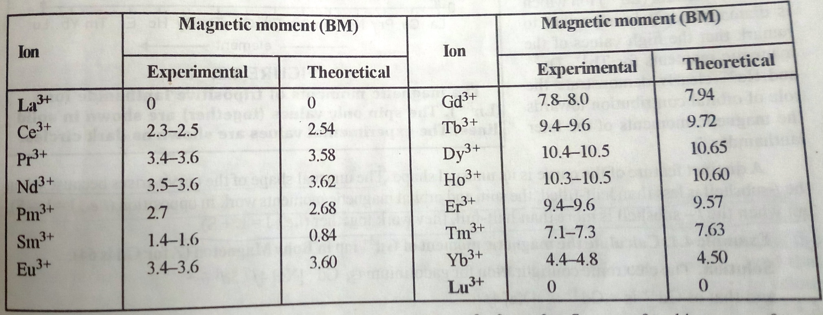
MAGNETIC PROPERTIES OF LANTHANIDES
Most of the Lanthanide ions are paramagnetic because of the presence of unpaired electrons in their 4f- sub shell.
The ions La³⁺, Lu³⁺, Ce⁴⁺ and Yb²⁺ are diamagnetic because hey have no unpaired electrons.
Table : Magnetic moment of Ln³⁺ ions

Slide 45
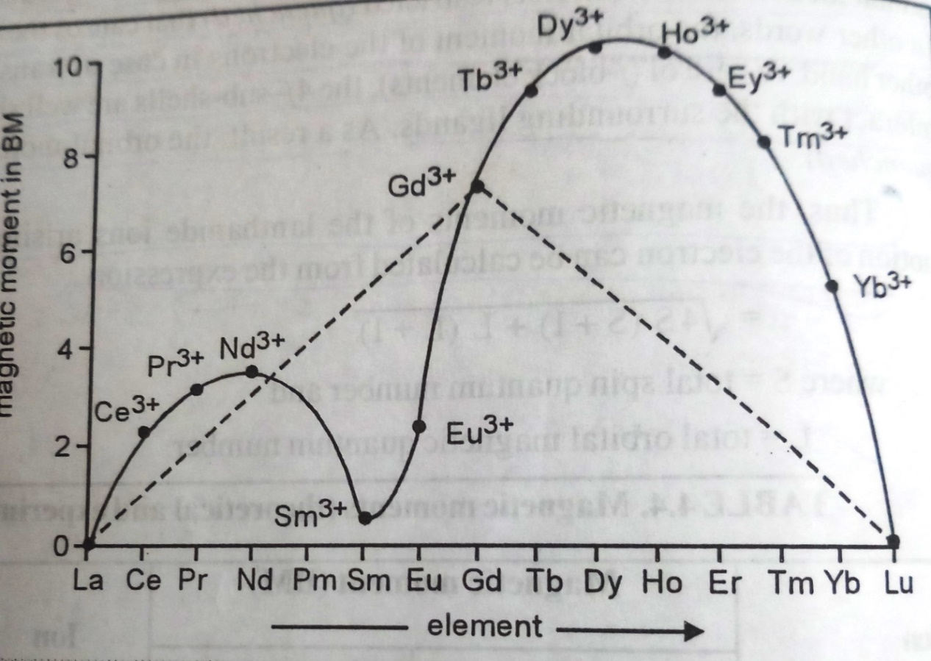
Magnetic Properties
Fig. The magnetic moments of tri-positive lanthanide ions (Ln³⁺).
The calculated spin only values are shown by doted lines.
The experimental values are shown as curve line.
This unusual shape of the curve arises because when the f-subshell is less than half filled, the spin and orbital magnetic moments work in opposition (i.e. J=L-S), but when the f-subshell is more than half-filled, they work together (i.e. J=L+S)
The magnetic moment value of d-block elements (transition elements) is spin only value.

Slide 46
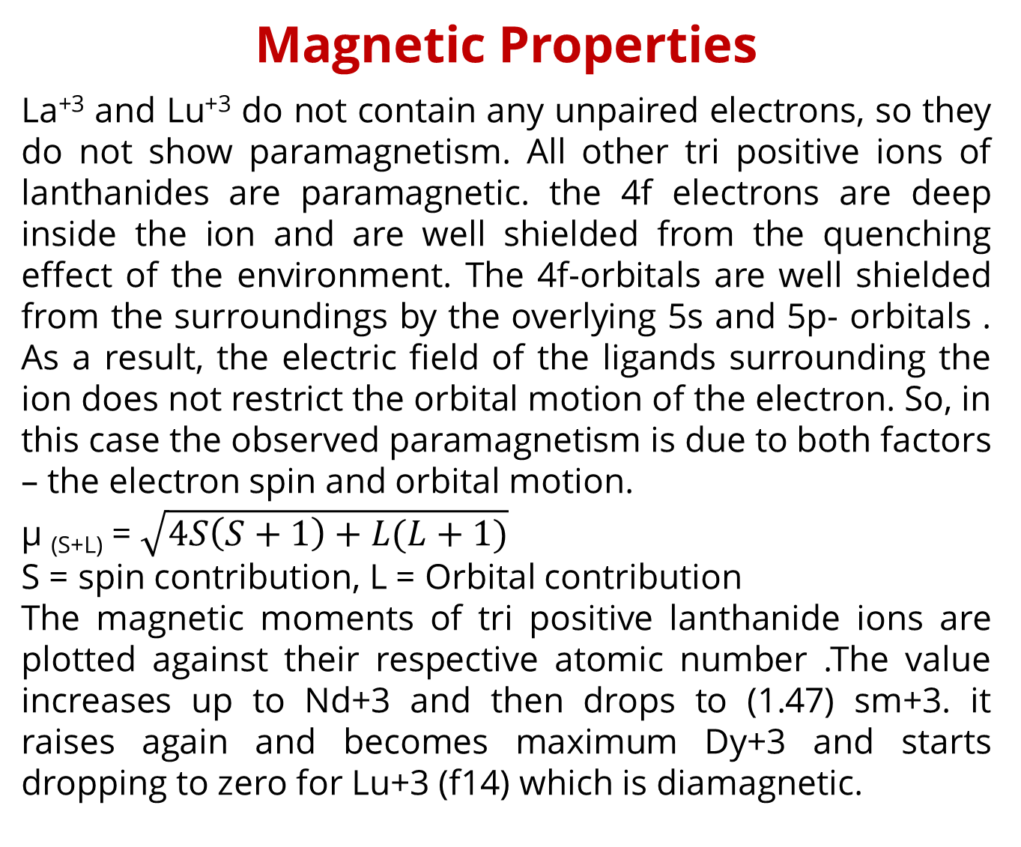
Magnetic Properties
La⁺³ and Lu⁺³ do not contain any unpaired electrons, so they do not show paramagnetism. All other tri positive ions of lanthanides are paramagnetic. the 4f electrons are deep inside the ion and are well shielded from the quenching effect of the environment. The 4f-orbitals are well shielded from the surroundings by the overlying 5s and 5p- orbitals . As a result, the electric field of the ligands surrounding the ion does not restrict the orbital motion of the electron. So, in this case the observed paramagnetism is due to both factors – the electron spin and orbital motion.
µ _{(S+L)} = $\sqrt{4S\left(S+1\right)+L(L+1)}$
S = spin contribution, L = Orbital contribution
The magnetic moments of tri positive lanthanide ions are plotted against their respective atomic number .The value increases up to Nd+3 and then drops to (1.47) sm+3. it raises again and becomes maximum Dy+3 and starts dropping to zero for Lu+3 (f14) which is diamagnetic.

Slide 47
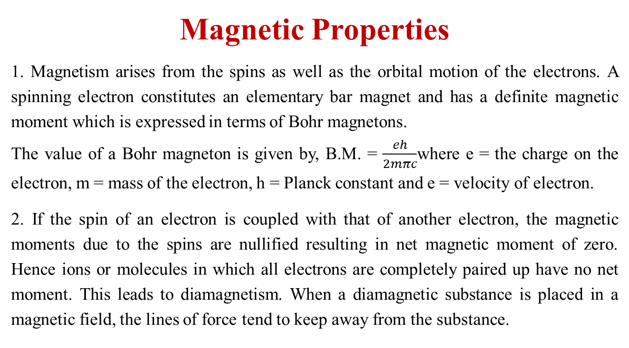
Magnetic Properties
1. Magnetism arises from the spins as well as the orbital motion of the electrons. A spinning electron constitutes an elementary bar magnet and has a definite magnetic moment which is expressed in terms of Bohr magnetons.
The value of a Bohr magneton is given by, B.M. = $\frac{eh}{2mπc}$where e = the charge on the electron, m = mass of the electron, h = Planck constant and e = velocity of electron.
2. If the spin of an electron is coupled with that of another electron, the magnetic moments due to the spins are nullified resulting in net magnetic moment of zero. Hence ions or molecules in which all electrons are completely paired up have no net moment. This leads to diamagnetism. When a diamagnetic substance is placed in a magnetic field, the lines of force tend to keep away from the substance.

Slide 48
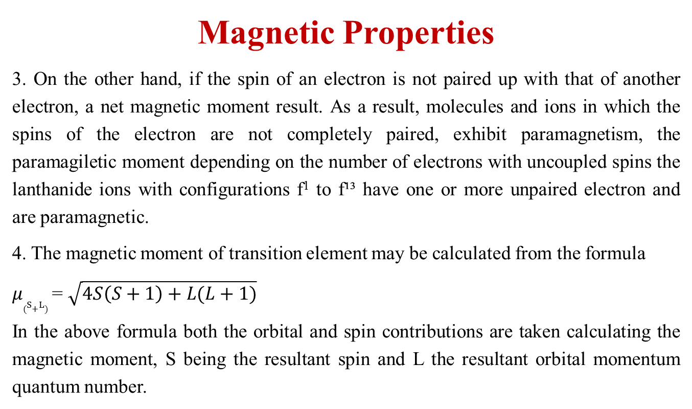
Magnetic Properties
3. On the other hand, if the spin of an electron is not paired up with that of another electron, a net magnetic moment result. As a result, molecules and ions in which the spins of the electron are not completely paired, exhibit paramagnetism, the paramagiletic moment depending on the number of electrons with uncoupled spins the lanthanide ions with configurations f¹ to f¹³ have one or more unpaired electron and are paramagnetic.
4. The magnetic moment of transition element may be calculated from the formula
$μ_{(S+L)}$ = $\sqrt{4S\left(S+1\right)+L(L+1)}$
In the above formula both the orbital and spin contributions are taken calculating the magnetic moment, S being the resultant spin and L the resultant orbital momentum quantum number.

Slide 49
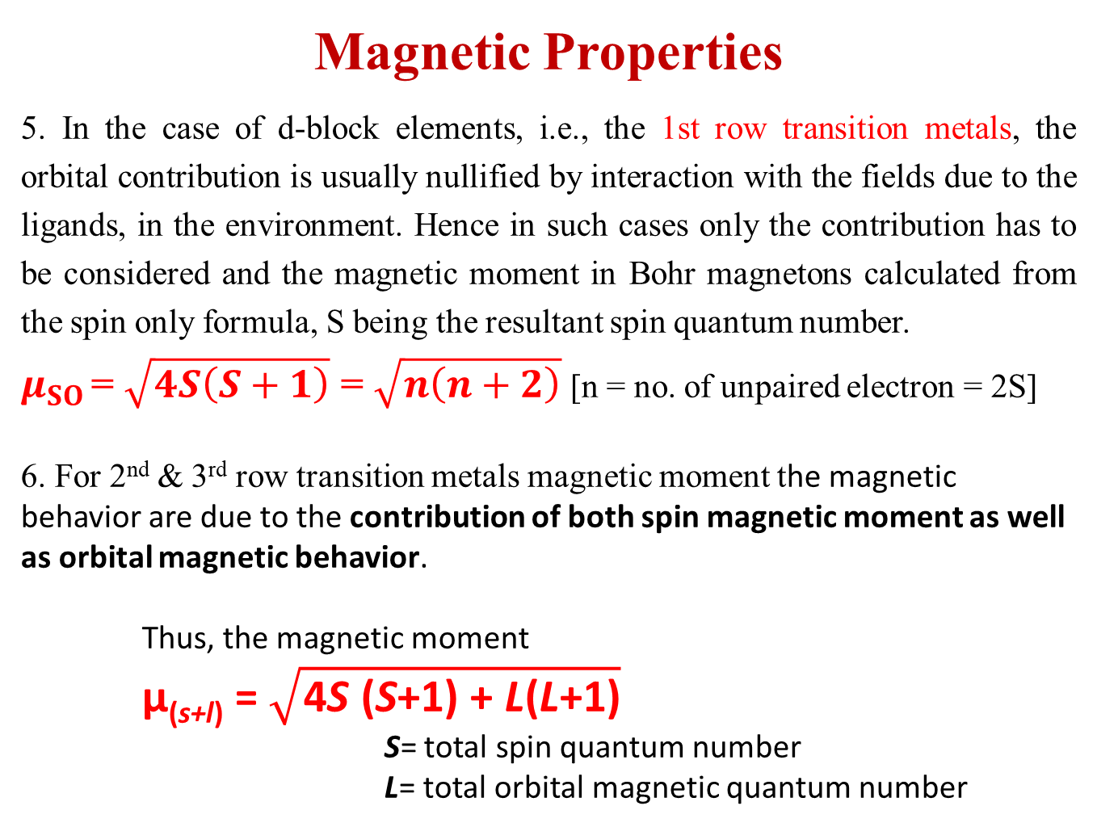
Magnetic Properties
5. In the case of d-block elements, i.e., the 1st row transition metals, the orbital contribution is usually nullified by interaction with the fields due to the ligands, in the environment. Hence in such cases only the contribution has to be considered and the magnetic moment in Bohr magnetons calculated from the spin only formula, S being the resultant spin quantum number.
$μ_{SO}$ = $\sqrt{4S\left(S+1\right)}$ = $\sqrt{n\left(n+2\right)}$ [n = no. of unpaired electron = 2S]
6. For 2nd & 3rd row transition metals magnetic moment the magnetic behavior are due to the contribution of both spin magnetic moment as well as orbital magnetic behavior.
Thus, the magnetic moment
μ_{(s+l)} = $\sqrt{\text{4}\text{S}\text{ (}\text{S}\text{+1) + }\text{L}\text{(}\text{L}\text{+1)}}$
S= total spin quantum number
L= total orbital magnetic quantum number

Slide 50
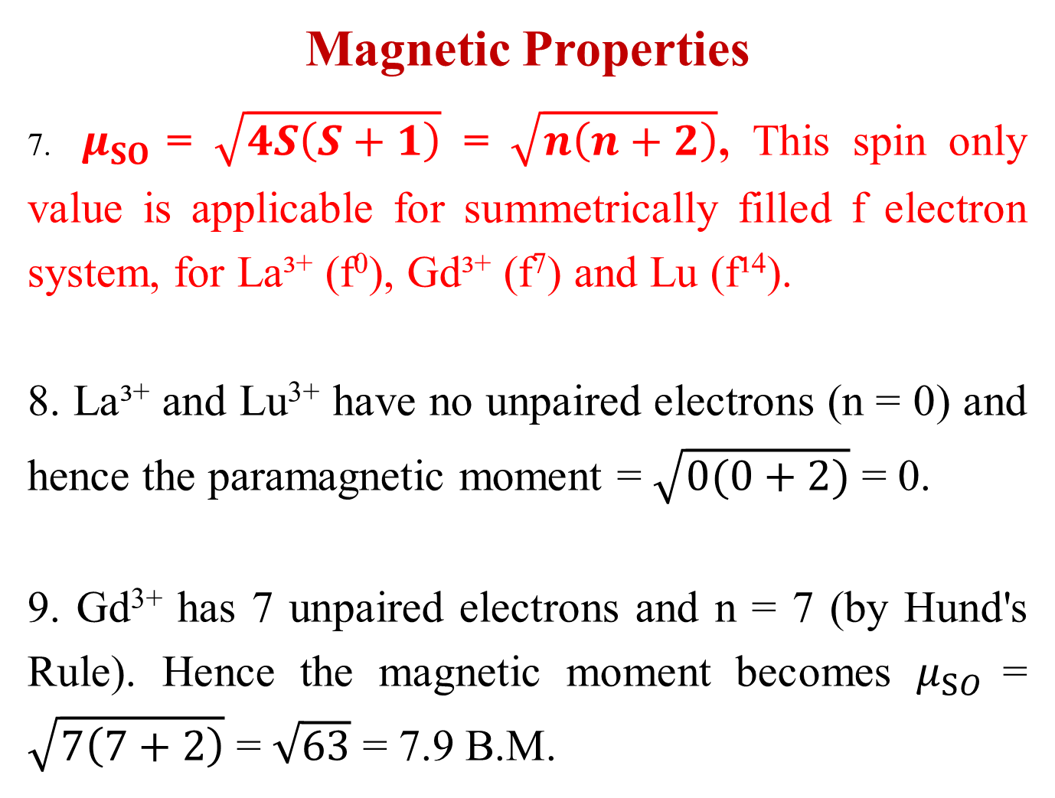
Magnetic Properties
7. $μ_{SO}$ = $\sqrt{4S\left(S+1\right)}$ = $\sqrt{n\left(n+2\right)}$, This spin only value is applicable for summetrically filled f electron system, for La³⁺ (f⁰), Gd³⁺ (f⁷) and Lu (f¹⁴).
8. La³⁺ and Lu³⁺ have no unpaired electrons (n = 0) and hence the paramagnetic moment = $\sqrt{0(0+2)}$ = 0.
9. Gd³⁺ has 7 unpaired electrons and n = 7 (by Hund's Rule). Hence the magnetic moment becomes $μ_{SO}$ = $\sqrt{7\left(7+2\right)}$ = $\sqrt{63}$ = 7.9 B.M.

Slide 51
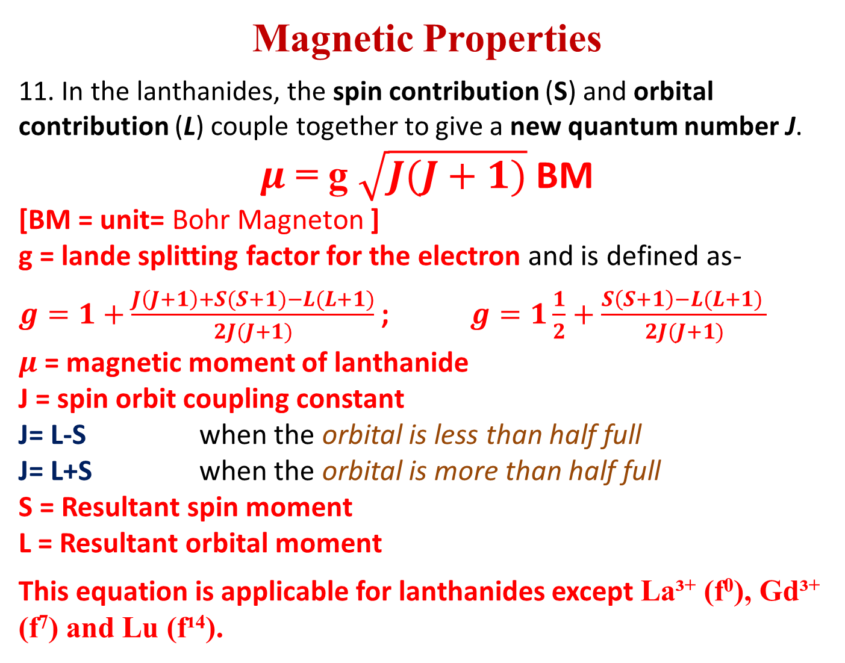
Magnetic Properties
11. In the lanthanides, the spin contribution (S) and orbital contribution (L) couple together to give a new quantum number J.
$μ$ = g $\sqrt{J(J+1)}$BM
[BM = unit= Bohr Magneton ]
    g = lande splitting factor for the electron and is defined as-
    $g=1+\frac{J\left(J+1\right)+S(S+1)−L(L+1)}{2J(J+1)}$ ; $g=1\frac{1}{2}+\frac{S\left(S+1\right)−L(L+1) }{2J(J+1)}$
    $μ$ = magnetic moment of lanthanide
    J = spin orbit coupling constant
    J= L-S when the orbital is less than half full
    J= L+S when the orbital is more than half full
    S = Resultant spin moment
    L = Resultant orbital moment
    This equation is applicable for lanthanides except La³⁺ (f⁰), Gd³⁺ (f⁷) and Lu (f¹⁴).

Slide 52
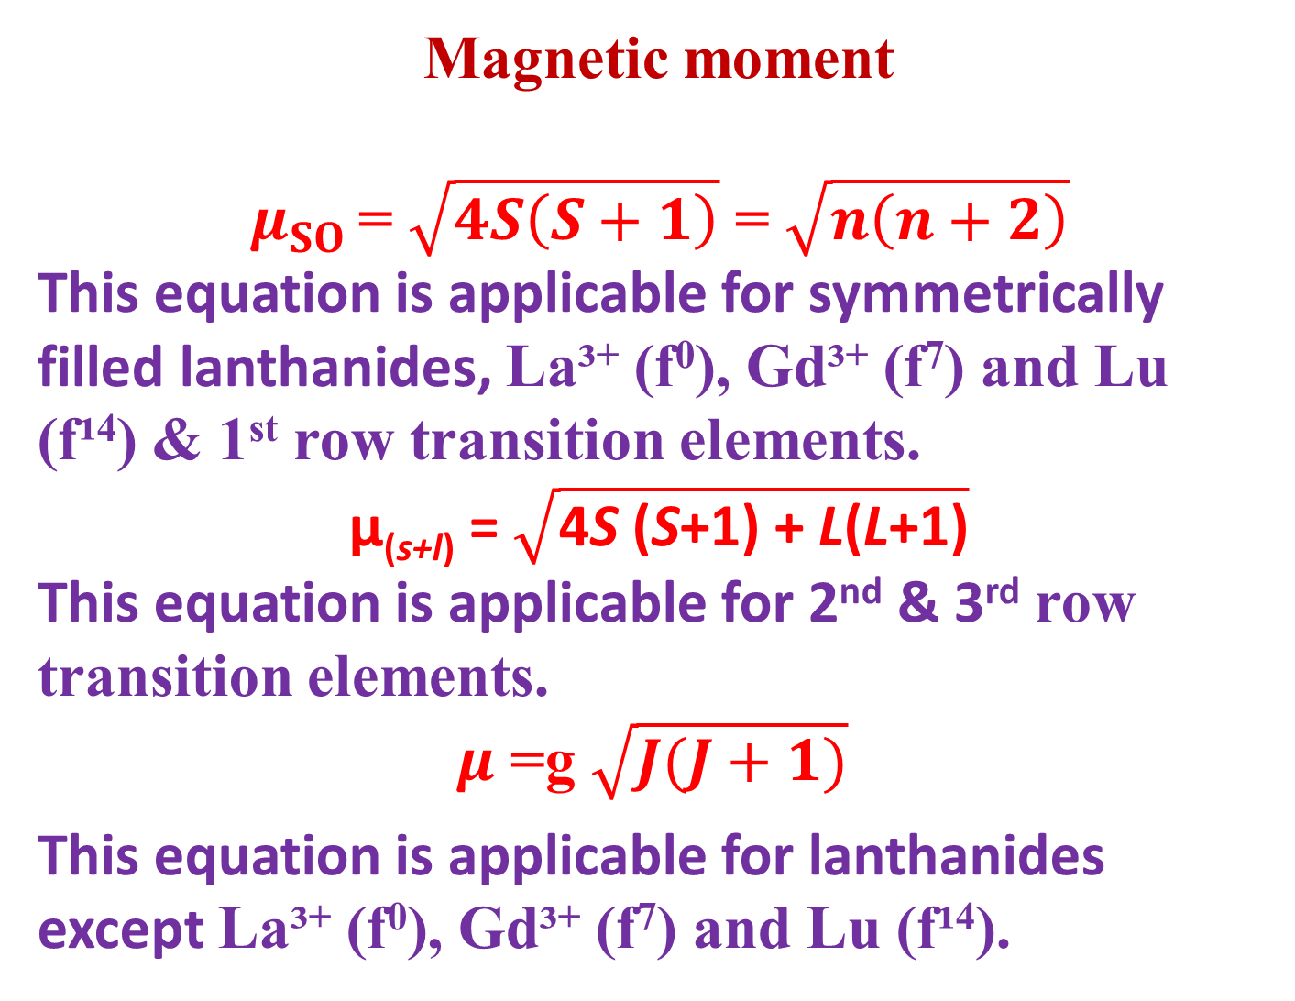
Magnetic moment
$$μ_{SO} \text{= }\sqrt{4S\left(S+1\right)}\text{ = }\sqrt{n\left(n+2\right)}$$
This equation is applicable for symmetrically filled lanthanides, La³⁺ (f⁰), Gd³⁺ (f⁷) and Lu (f¹⁴) & 1st row transition elements.
$\text{μ}\text{(}\text{s}\text{+}\text{l}\text{)} \text{= }\sqrt{\text{4}\text{S}\text{ (}\text{S}\text{+1) + }\text{L}\text{(}\text{L}\text{+1)}}$
This equation is applicable for 2nd & 3rd row transition elements.
$μ$ =g $\sqrt{J(J+1)}$
    This equation is applicable for lanthanides except La³⁺ (f⁰), Gd³⁺ (f⁷) and Lu (f¹⁴).

Slide 53
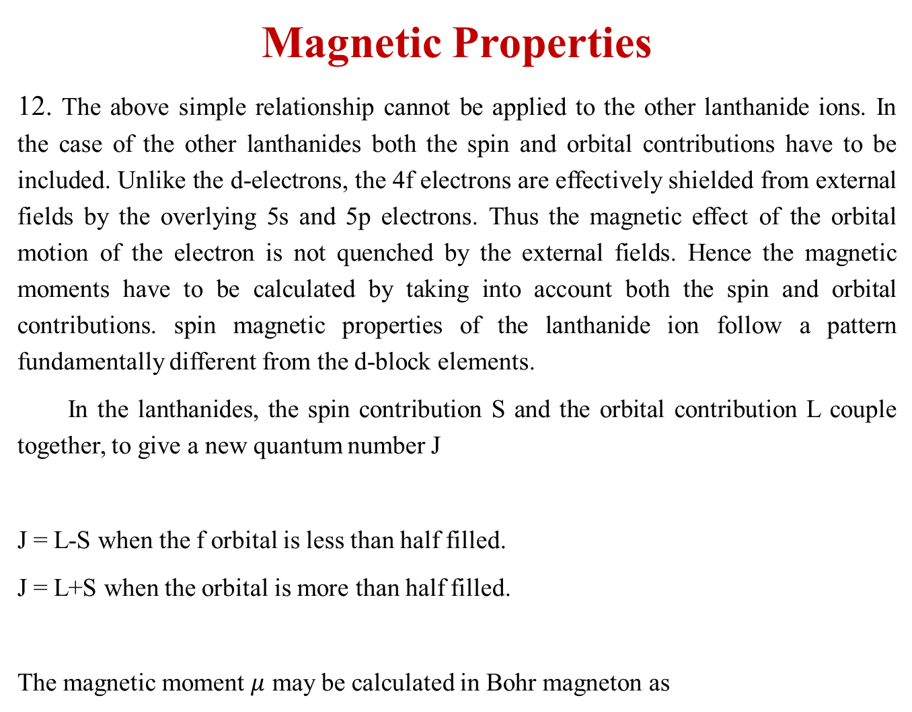
Magnetic Properties
12. The above simple relationship cannot be applied to the other lanthanide ions. In the case of the other lanthanides both the spin and orbital contributions have to be included. Unlike the d-electrons, the 4f electrons are effectively shielded from external fields by the overlying 5s and 5p electrons. Thus the magnetic effect of the orbital motion of the electron is not quenched by the external fields. Hence the magnetic moments have to be calculated by taking into account both the spin and orbital contributions. spin magnetic properties of the lanthanide ion follow a pattern fundamentally different from the d-block elements.
In the lanthanides, the spin contribution S and the orbital contribution L couple together, to give a new quantum number J
J = L-S when the f orbital is less than half filled.
J = L+S when the orbital is more than half filled.
The magnetic moment $μ$ may be calculated in Bohr magneton as

Slide 54
Magnetic Properties
13. The magnetic moments of lanthanide ions are in good agreement with the formula taken into account both the spin and orbital factors. The coupling constant (J) for Eu³⁺ is only about 300 cm⁻¹. This indicates that the difference between the ground state and next excited state is small. The energy of thermal motion is sufficient to cause the transition and partially populate the higher state. Because of this, the magnetic properties are not solely determined by the ground state configuration. Measure of magnetic moments at low temperature eliminates the thermal factor by preventing the population in the higher energy level. The magnetic moment of Eu³⁺ is close to zero as expected.)

Slide 55
Magnetic Properties
14. The unusual shape of the curve obtained by plotting the magnetic susceptibility against the atomic number of the lanthanide ions, arises on account of Hund's third rule. When the f level is less than half filled, the spin and orbital moment a work in opposition, (J = L-S). When the f-shell is more than half full the spin and orbital contribution work together, J = L + S.

Slide 56
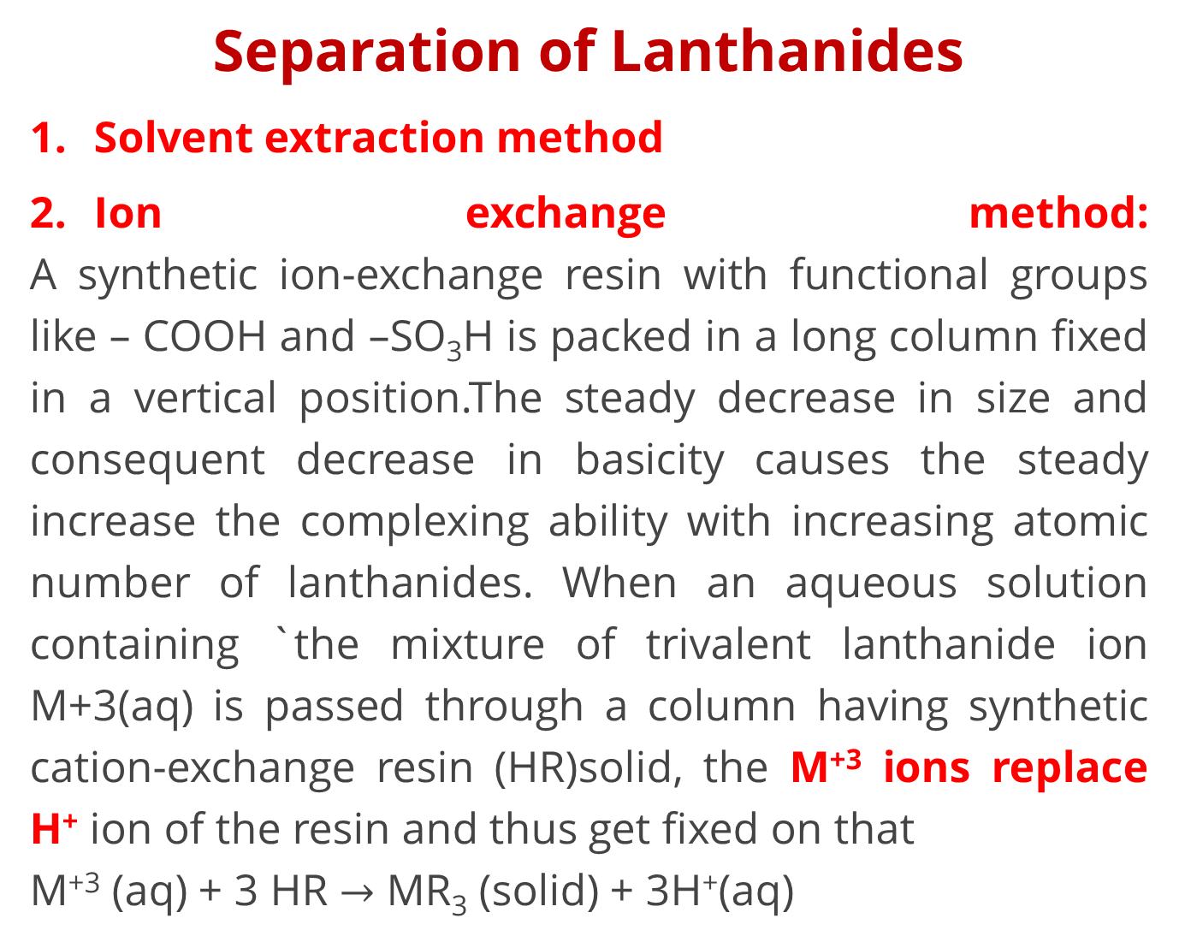
Separation of Lanthanides
Solvent extraction method
Ion exchange method:
A synthetic ion-exchange resin with functional groups like – COOH and –SO₃H is packed in a long column fixed in a vertical position.The steady decrease in size and consequent decrease in basicity causes the steady increase the complexing ability with increasing atomic number of lanthanides. When an aqueous solution containing `the mixture of trivalent lanthanide ion M+3(aq) is passed through a column having synthetic cation-exchange resin (HR)solid, the M⁺³ ions replace H⁺ ion of the resin and thus get fixed on that
M⁺³ (aq) + 3 HR $→$ MR₃ (solid) + 3H⁺(aq)

Slide 57
Separation of Lanthanides
Small Lu 3+ gets more hydrated than La 3+ and is bigger in size
Small Lu 3+ gets more hydrated than La 3+ and is bigger in size. So La(aq) 3+ gets strongly bound to the resin column than others.In order to recover M3+ ions fixed on the resin, the column is eluted with a citric acid – ammonium citrate solution (eluant). During elution process NH4+ ions replace M+3 ion and M- citrate complexes are formed.The bigger aquated ion is least strongly held and comes out first. Other ions remain on the column and can be separated by repeated elution.R – M3+ + NH R - NH M3+ - citrate

Slide 58
Electronic Configuration of Actinides
Element | Seaborg view | Dawson View | Oxidation States
Ac | [Rd] 5f0 6d1 7s2 | [Rd] 5f0 6d1 7s2 | +3, +2
Th | [Rd] 5f1 6d1 7s2 | [Rd] 5f0 6d2 7s2 | +4
Pa | [Rd] 5f2 6d1 7s2 | [Rd] 5f0 6d3 7s2 | +4, +5
U | [Rd] 5f3 6d1 7s2 | [Rd] 5f0 6d4 7s2 | +4, +5, +6
Np | [Rd] 5f4 6d1 7s2 |  | +4, +5, +6, +7
Pu | [Rd] 5f5 6d1 7s2 |  | +4 , +5 , +6
Am | [Rd] 5f6 6d1 7s2 |  | +3, +4, +5, +6
Cm | [Rd] 5f7 6d1 7s2 |  | +3
Bk | [Rd] 5f8 6d1 7s2 |  | +3
Cf | [Rd] 5f9 6d1 7s2 |  | +3
Es | [Rd] 5f10 6d1 7s2 |  | +3
Fm | [Rd] 5f11 6d1 7s2 |  | +3
Md | [Rd] 5f12 6d1 7s2 |  | +3
No | [Rd] 5f13 6d1 7s2 |  | +2 (f14)
Lr | [Rd] 5f14 6d1 7s2 |  | +3

Slide 59
Actinides
1.Atomic Radii:
Steady decrease from Ac to Lr due to imperfect shielding by f- orbitals due to their diffused shape is known as Actinide contraction.
2. Oxidation States:
–+3 is most common stable O.S.
Higher oxidation states are more common for elements upto Np.
O. S. upto +6 are stable.
3. Colour:
Metals, ions are coloured due to f-f transitions and intense change transfer transitions.
fº, f⁷, f¹⁴ –ions are colour less.

Slide 60
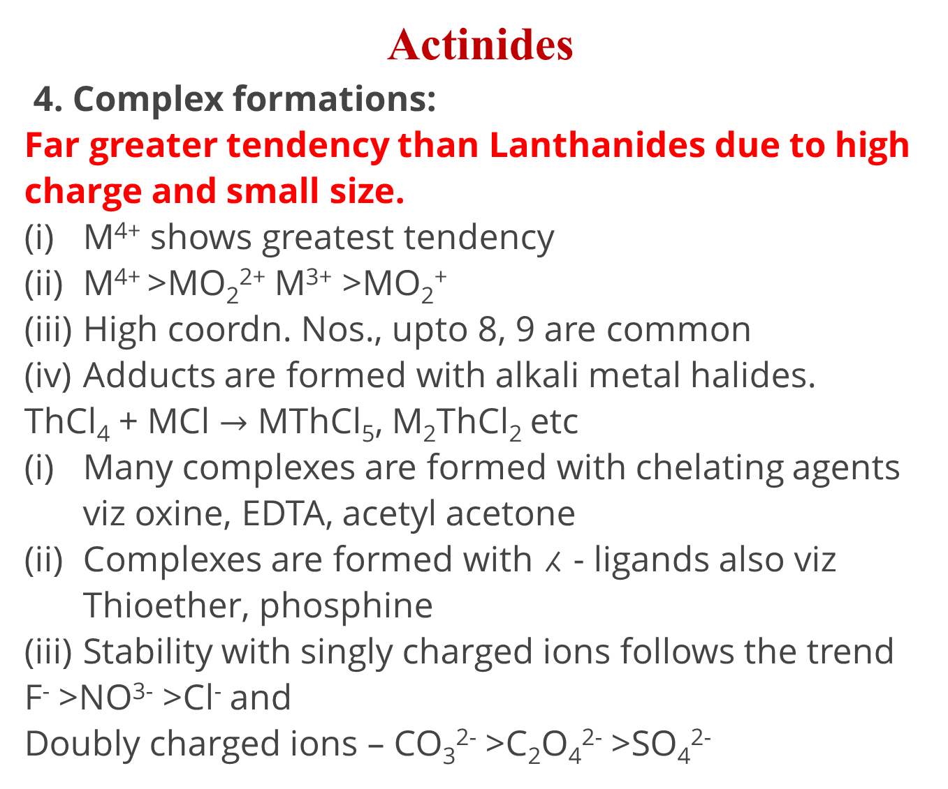
Actinides
4. Complex formations:
Far greater tendency than Lanthanides due to high charge and small size.
M⁴⁺ shows greatest tendency
M⁴⁺ >MO₂²⁺ M³⁺ >MO₂⁺
High coordn. Nos., upto 8, 9 are common
Adducts are formed with alkali metal halides.
ThCl₄ + MCl $→$ MThCl₅, M₂ThCl₂ etc
Many complexes are formed with chelating agents viz oxine, EDTA, acetyl acetone
Complexes are formed with ⁁ - ligands also viz Thioether, phosphine
Stability with singly charged ions follows the trend
F⁻ >NO³⁻ >Cl⁻ and
Doubly charged ions – CO₃²⁻ >C₂O₄²⁻ >SO₄²⁻

Slide 61
Comparison between lanthanides and actinides
Similarities
Oxidation state of +3 dominates in both the series.
In both the series forbitals are being progressively filled.
Just like lanthanide contraction we have actinide contraction.
The nitrates, perchlorates and sulphates of trivalent actinides as well as lanthanides are soluble while the hydroxides, fluorides and carbonates are insoluble.
In the absorption spectra of the elements of both the series sharp line-like bands appear due toff transitions.

Slide 62
Comparison between lanthanides and actinides
Difference
Lanthanides | Actinides
Binding energy of 4f are higher. 4f electrons have greater shielding effect. Maximum oxidation state exhibited bylanthanides is +4, e.g., Ce²+. They don't form oxocations. Except prometheium they are non-radioactive. They do not form complexes easily. Their complexes with π-bonding ligands are not known. They are paramagnetic but magnetic properties can be easily explained. | Binding energies of 5f are lower. 5 felectrons have poor shielding effect. Due to lower binding energies they show higher oxidation states such as +4, +5 and +6. They form oxocations such as UO2+, NpO, PuO. All of them are radioactive. They form complexes even with π- bonding ligands such as alkyl phosphines. thioethers etc. They are also paramagnetic but it is difficult to explain magnetic properties.

Slide 63
Reference
Ashim K Das , Fundamental Concept of Inorganic Chemistry, CBC Publishers & Distributors, Volume 1

Slide 64
Thank you

